Slide 1
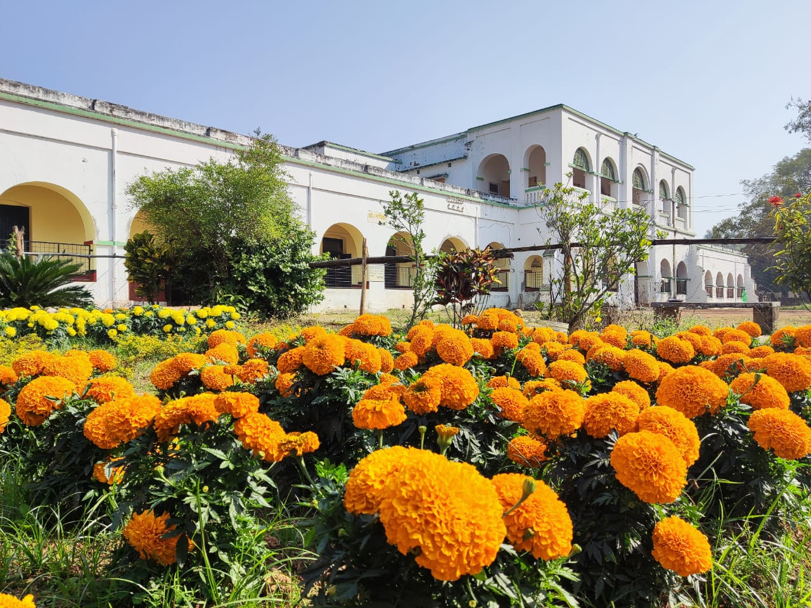
Khristiya Seva Niketan Hospital
West Midlands Synod Jubilee Appeal

Slide 2
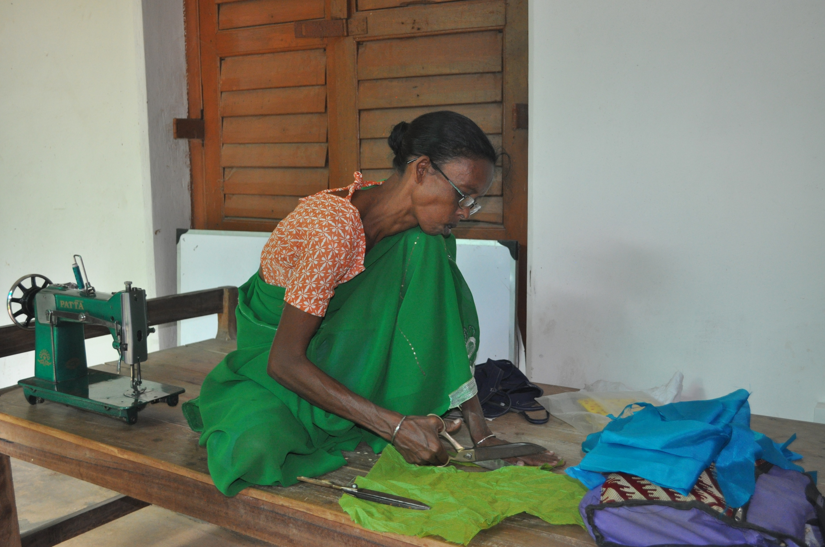
Community Approach for Rural Development (CAFORD)
seeking to improve public health via community-based initiatives and a hospital referral service

Slide 3
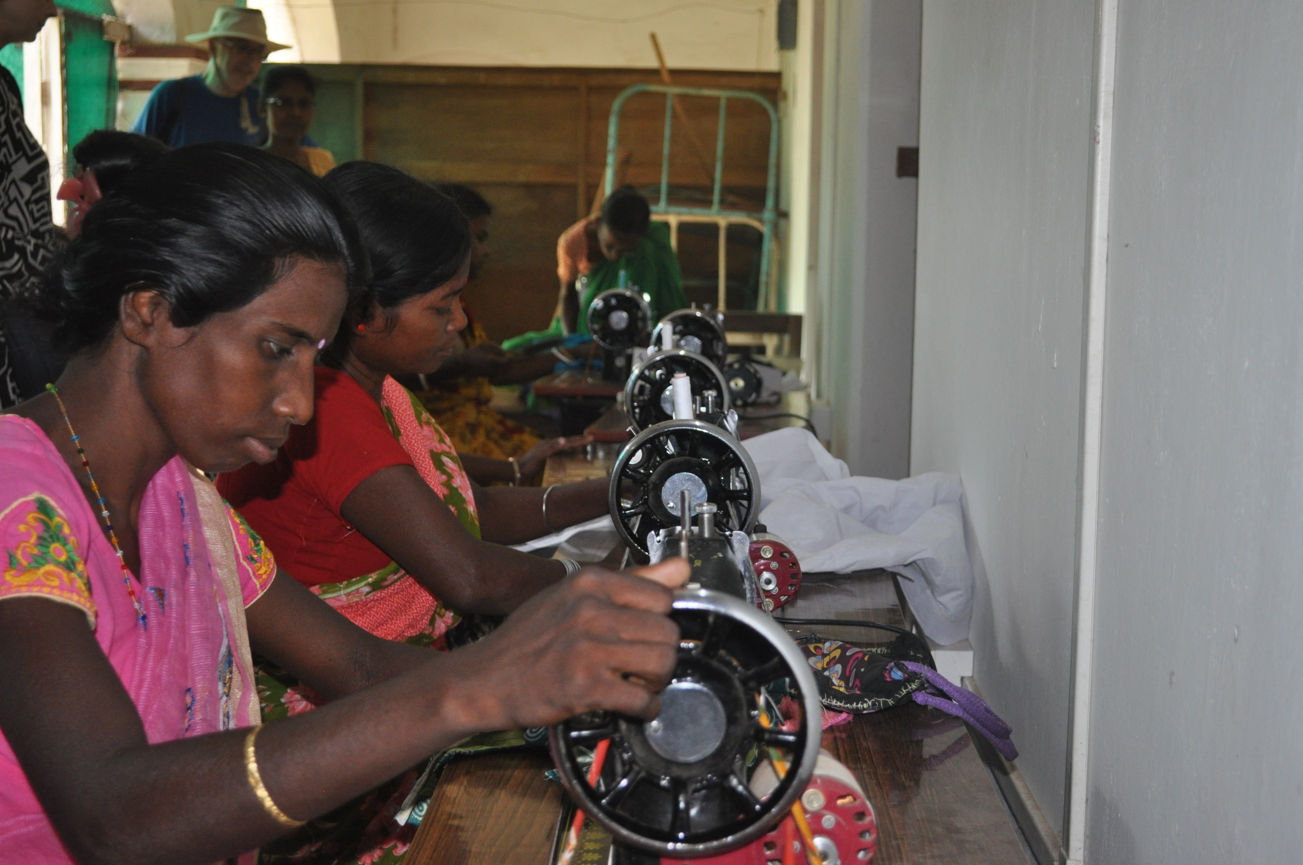
CAFORD sewing skills classes at KSN

Slide 4
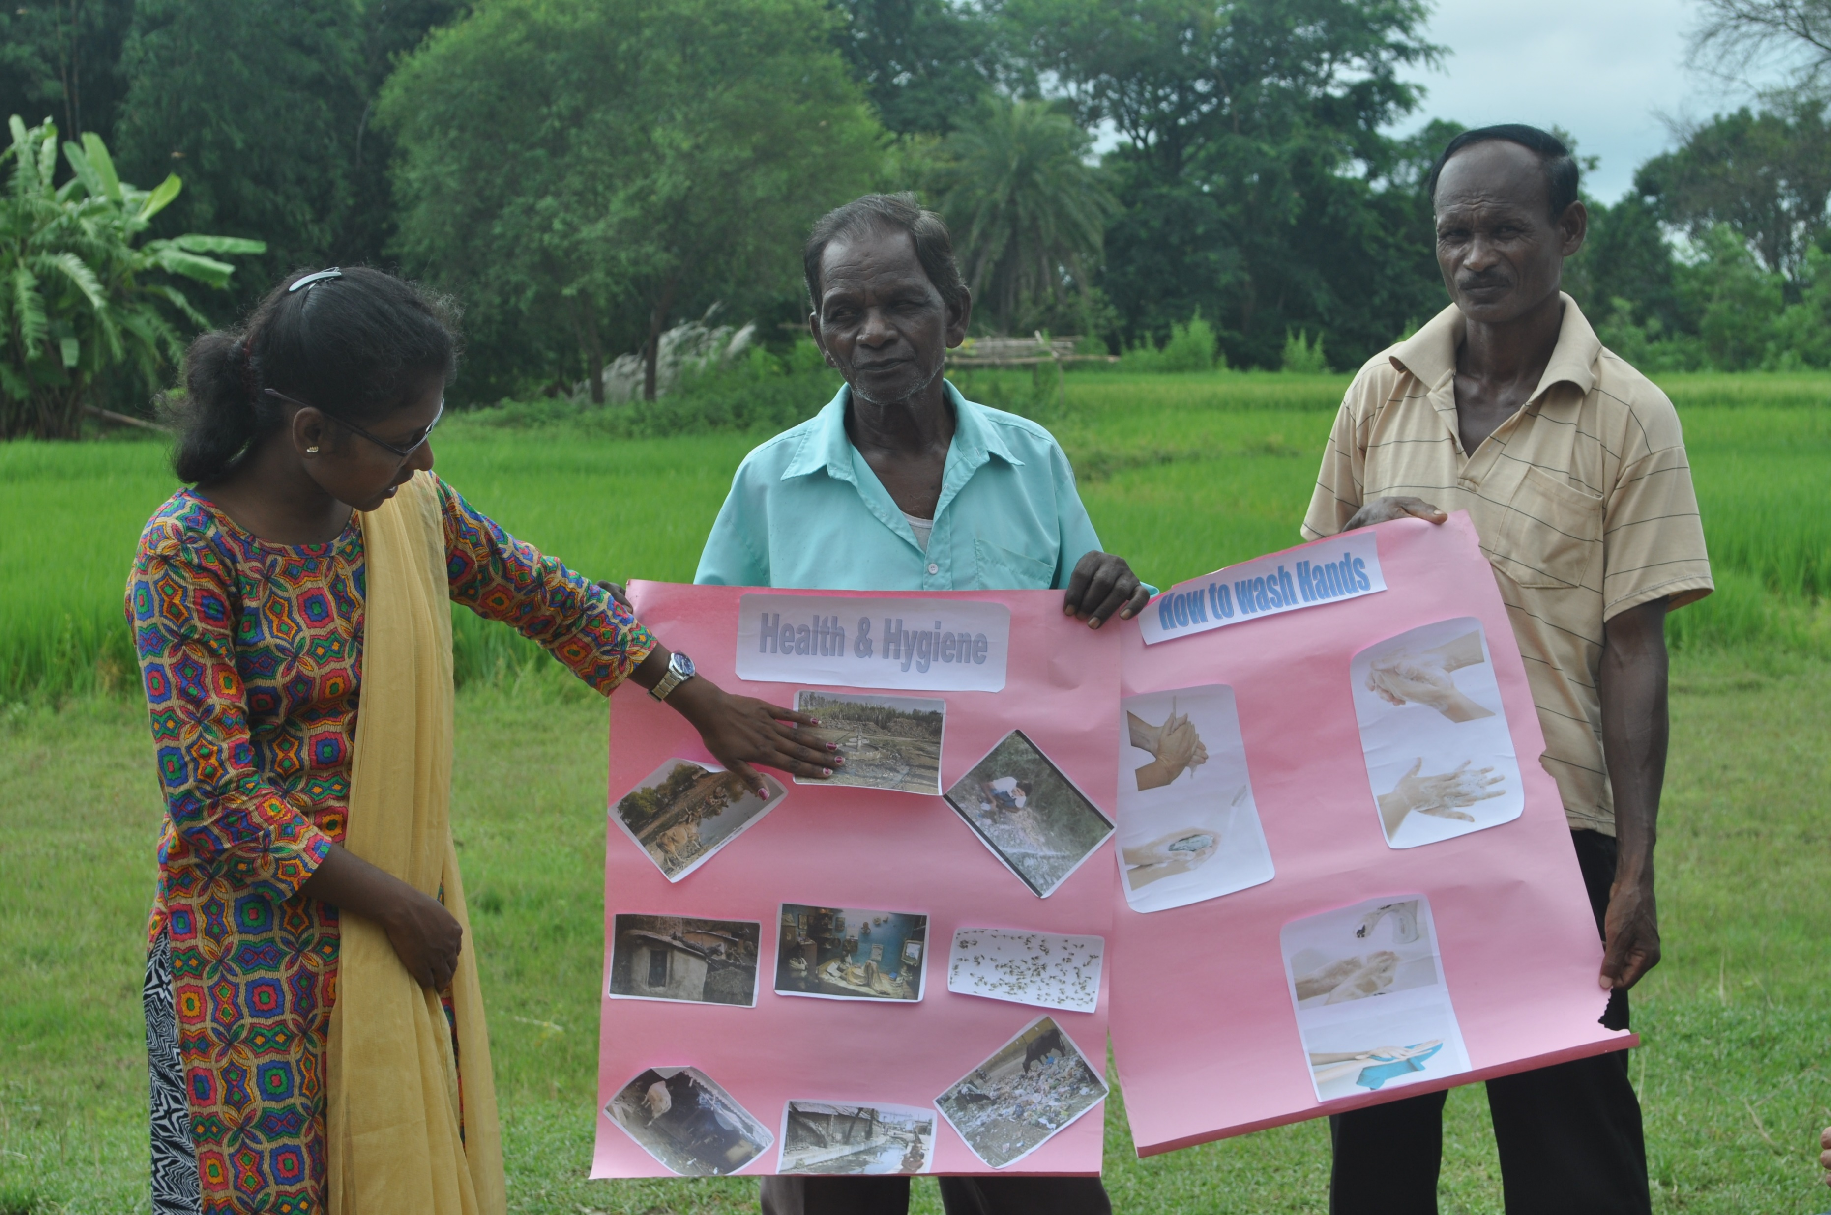
In the community teaching hand hygiene…

Slide 5
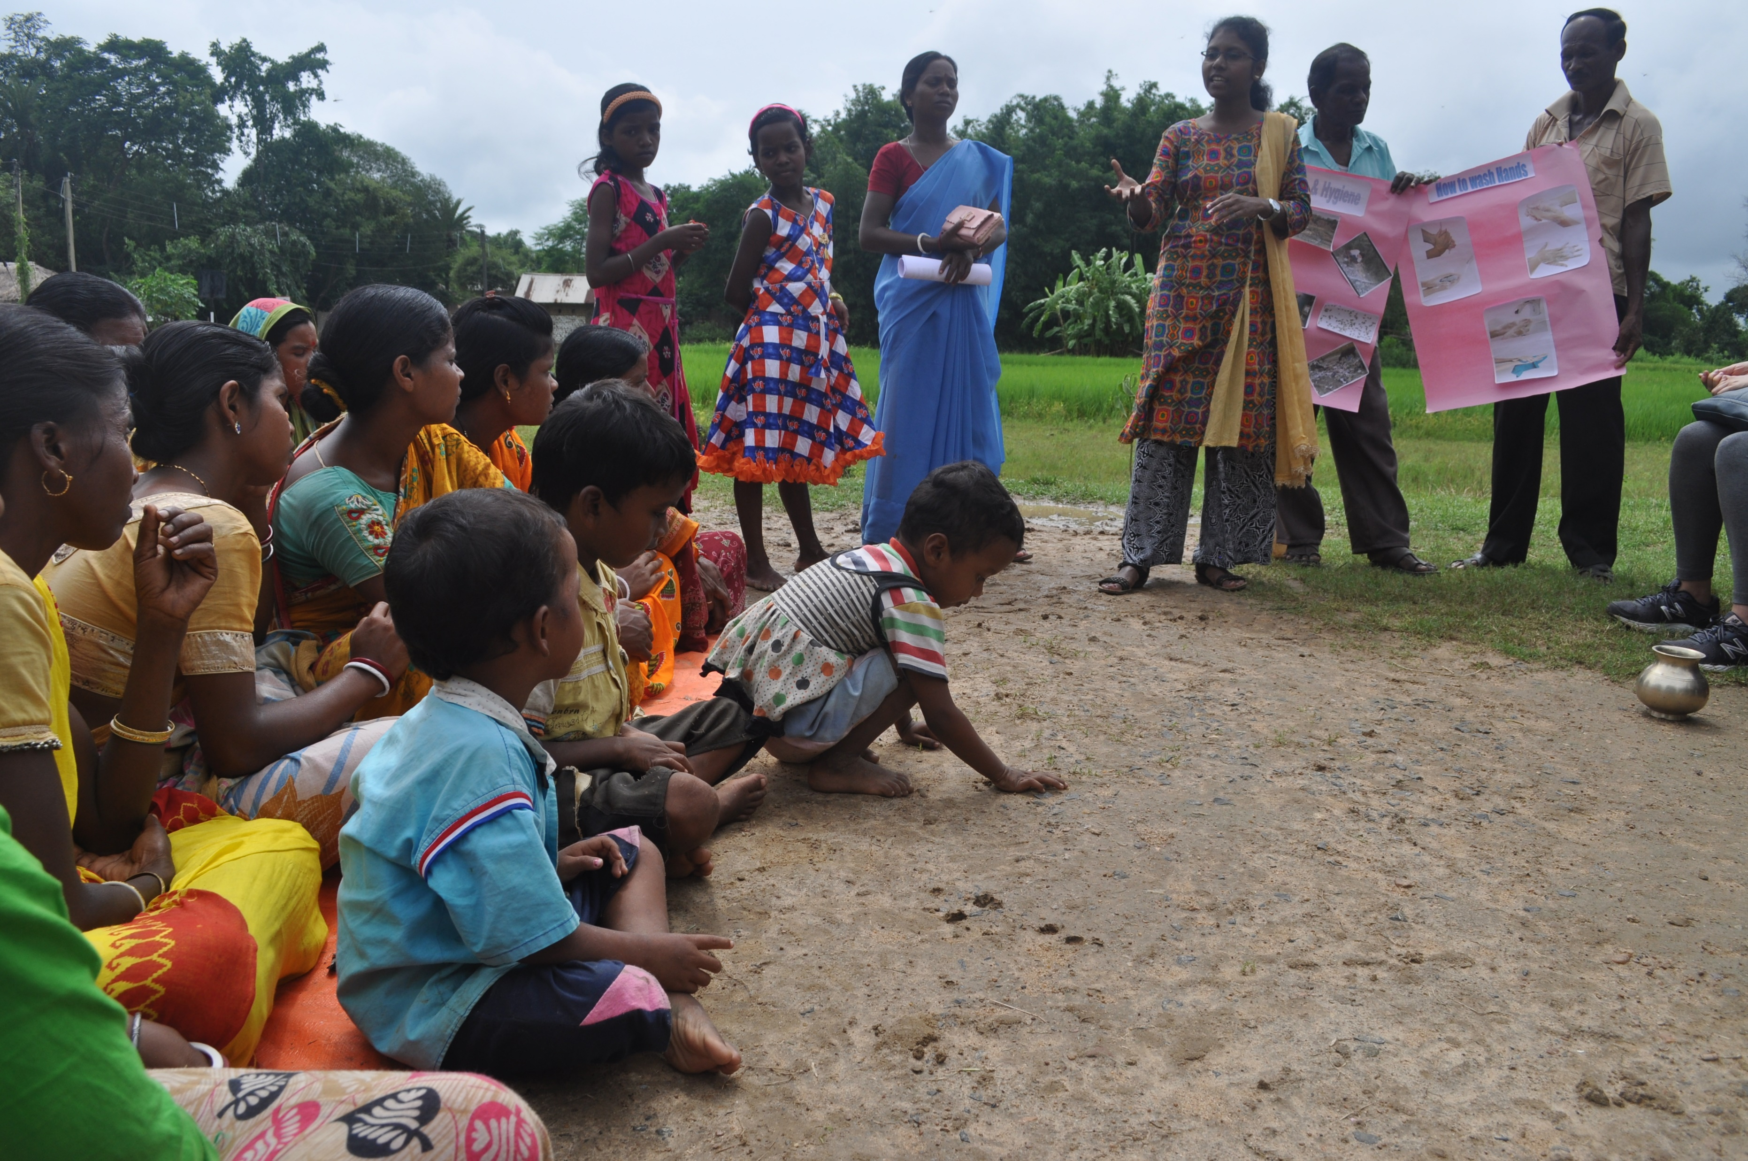
…as children play in the dirt!

Slide 6
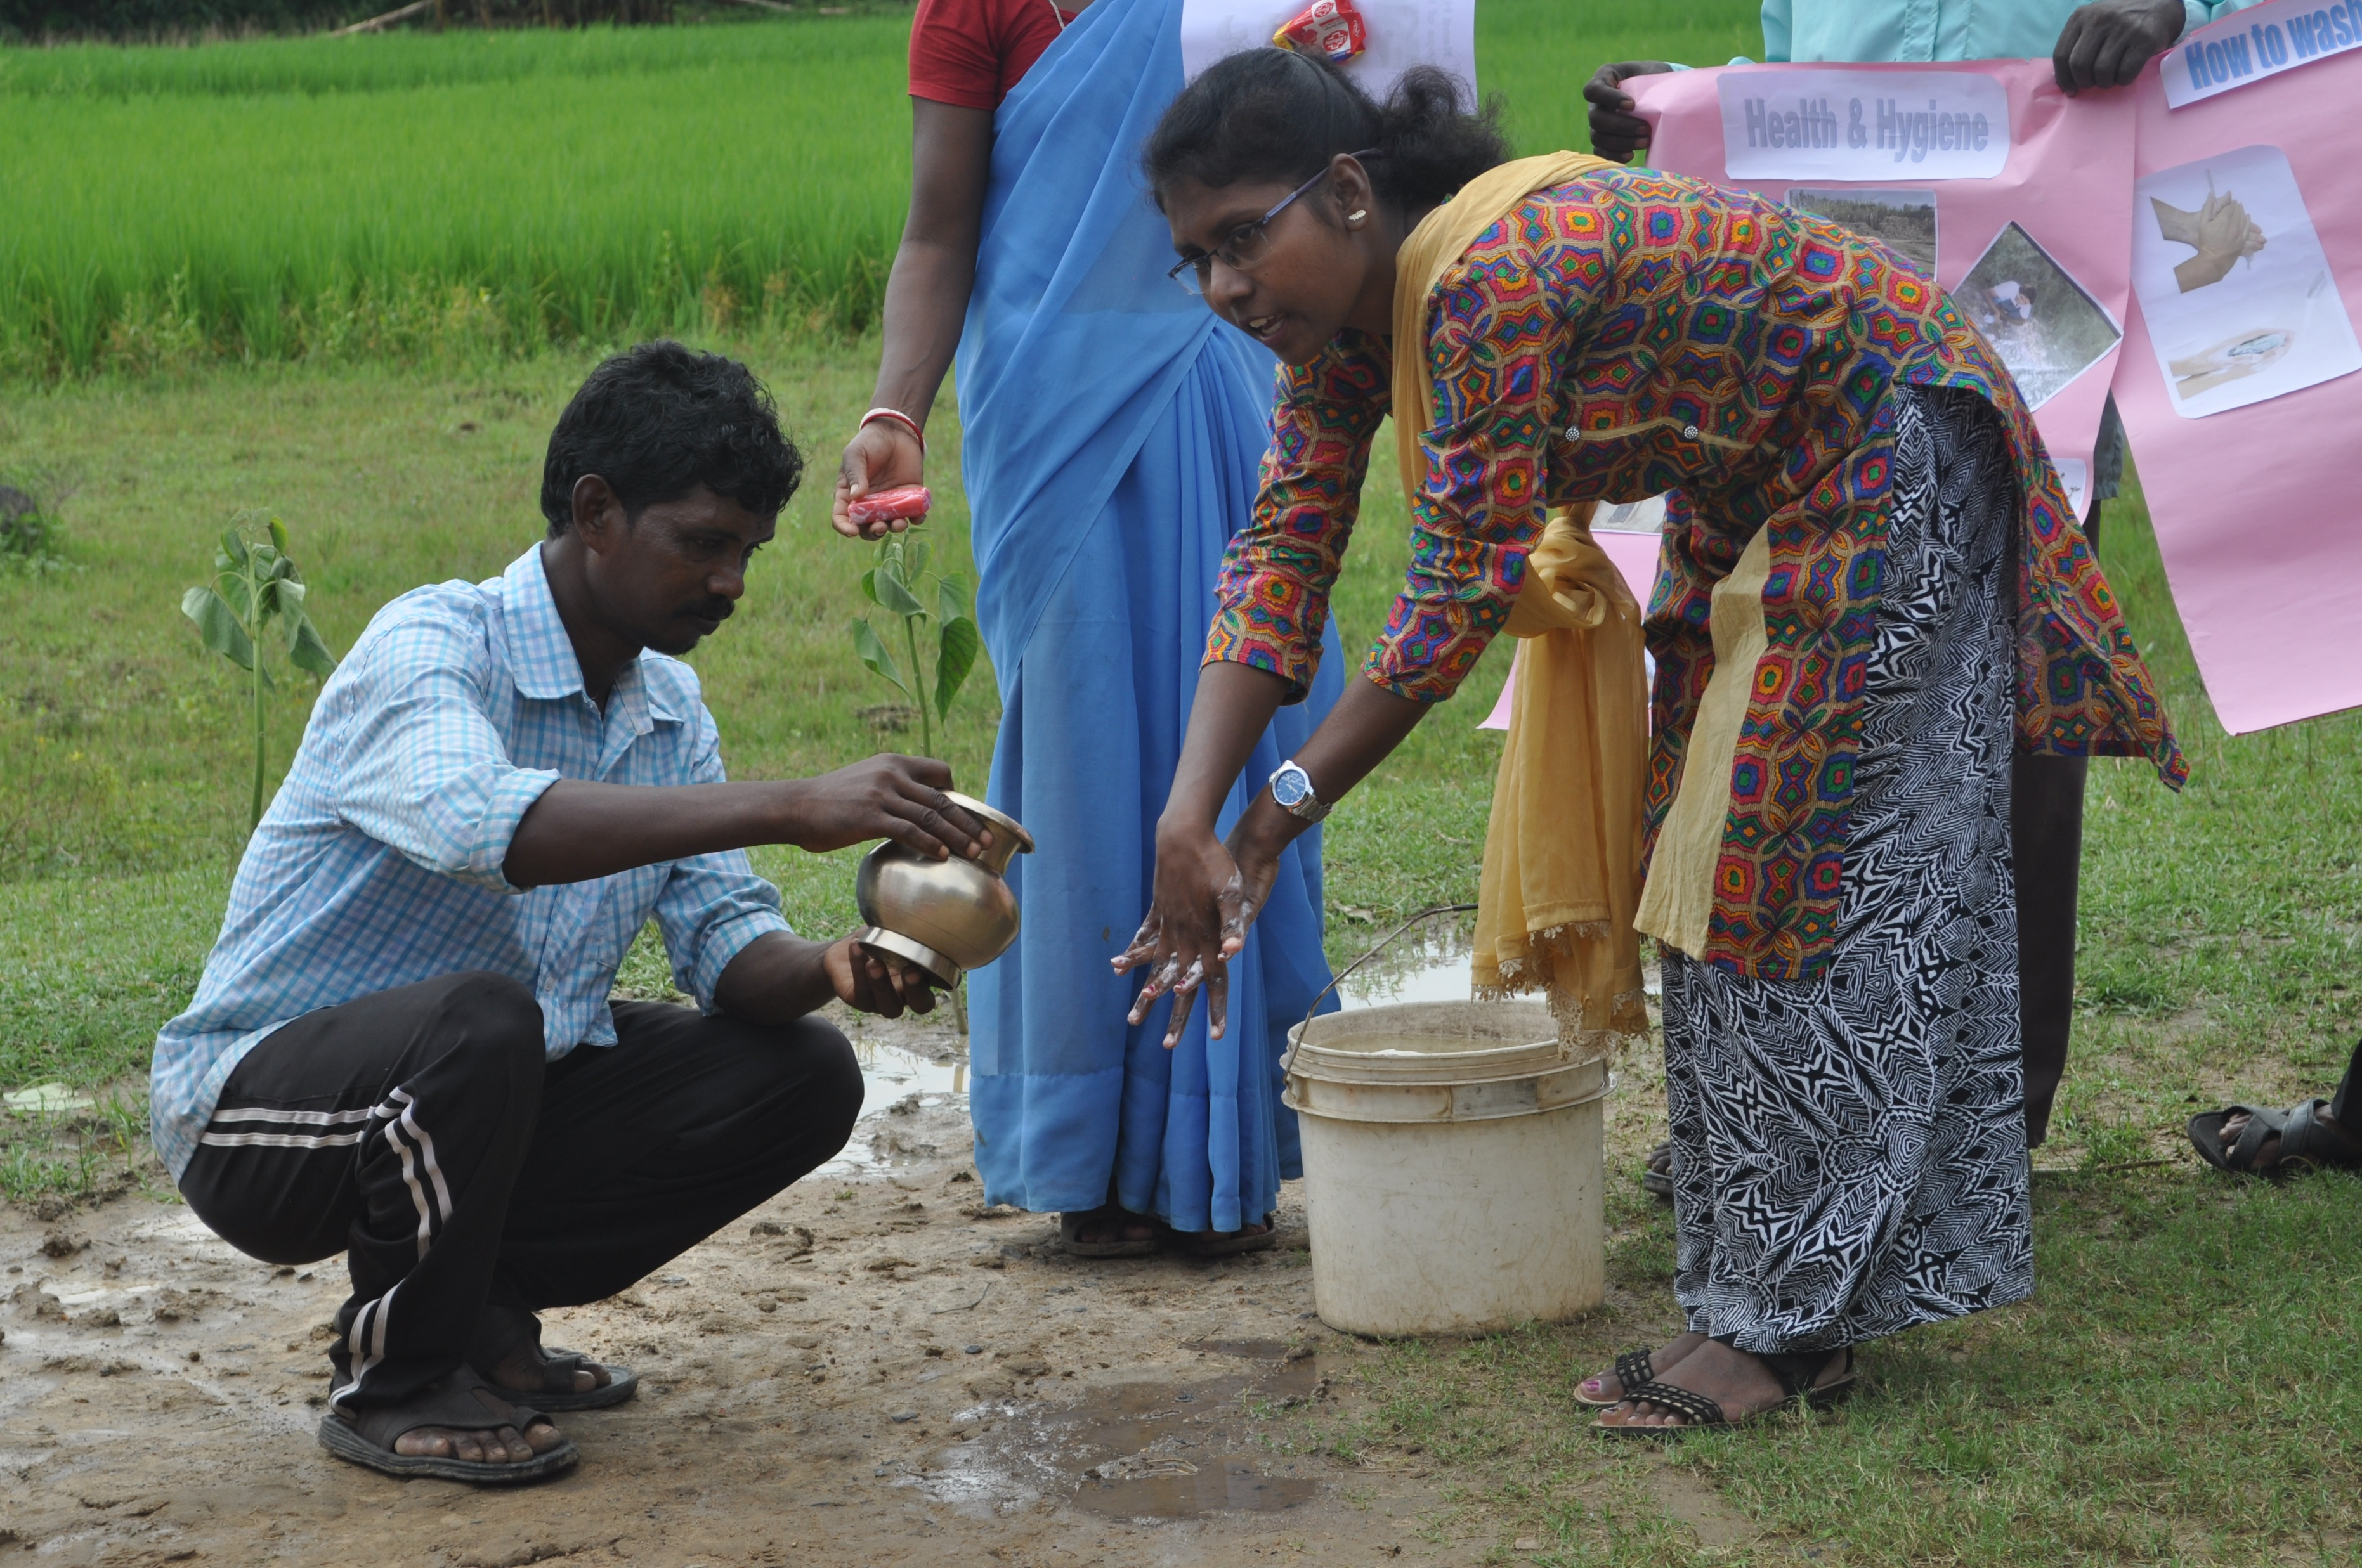
Time for a
practical hand washing demonstration

Slide 7
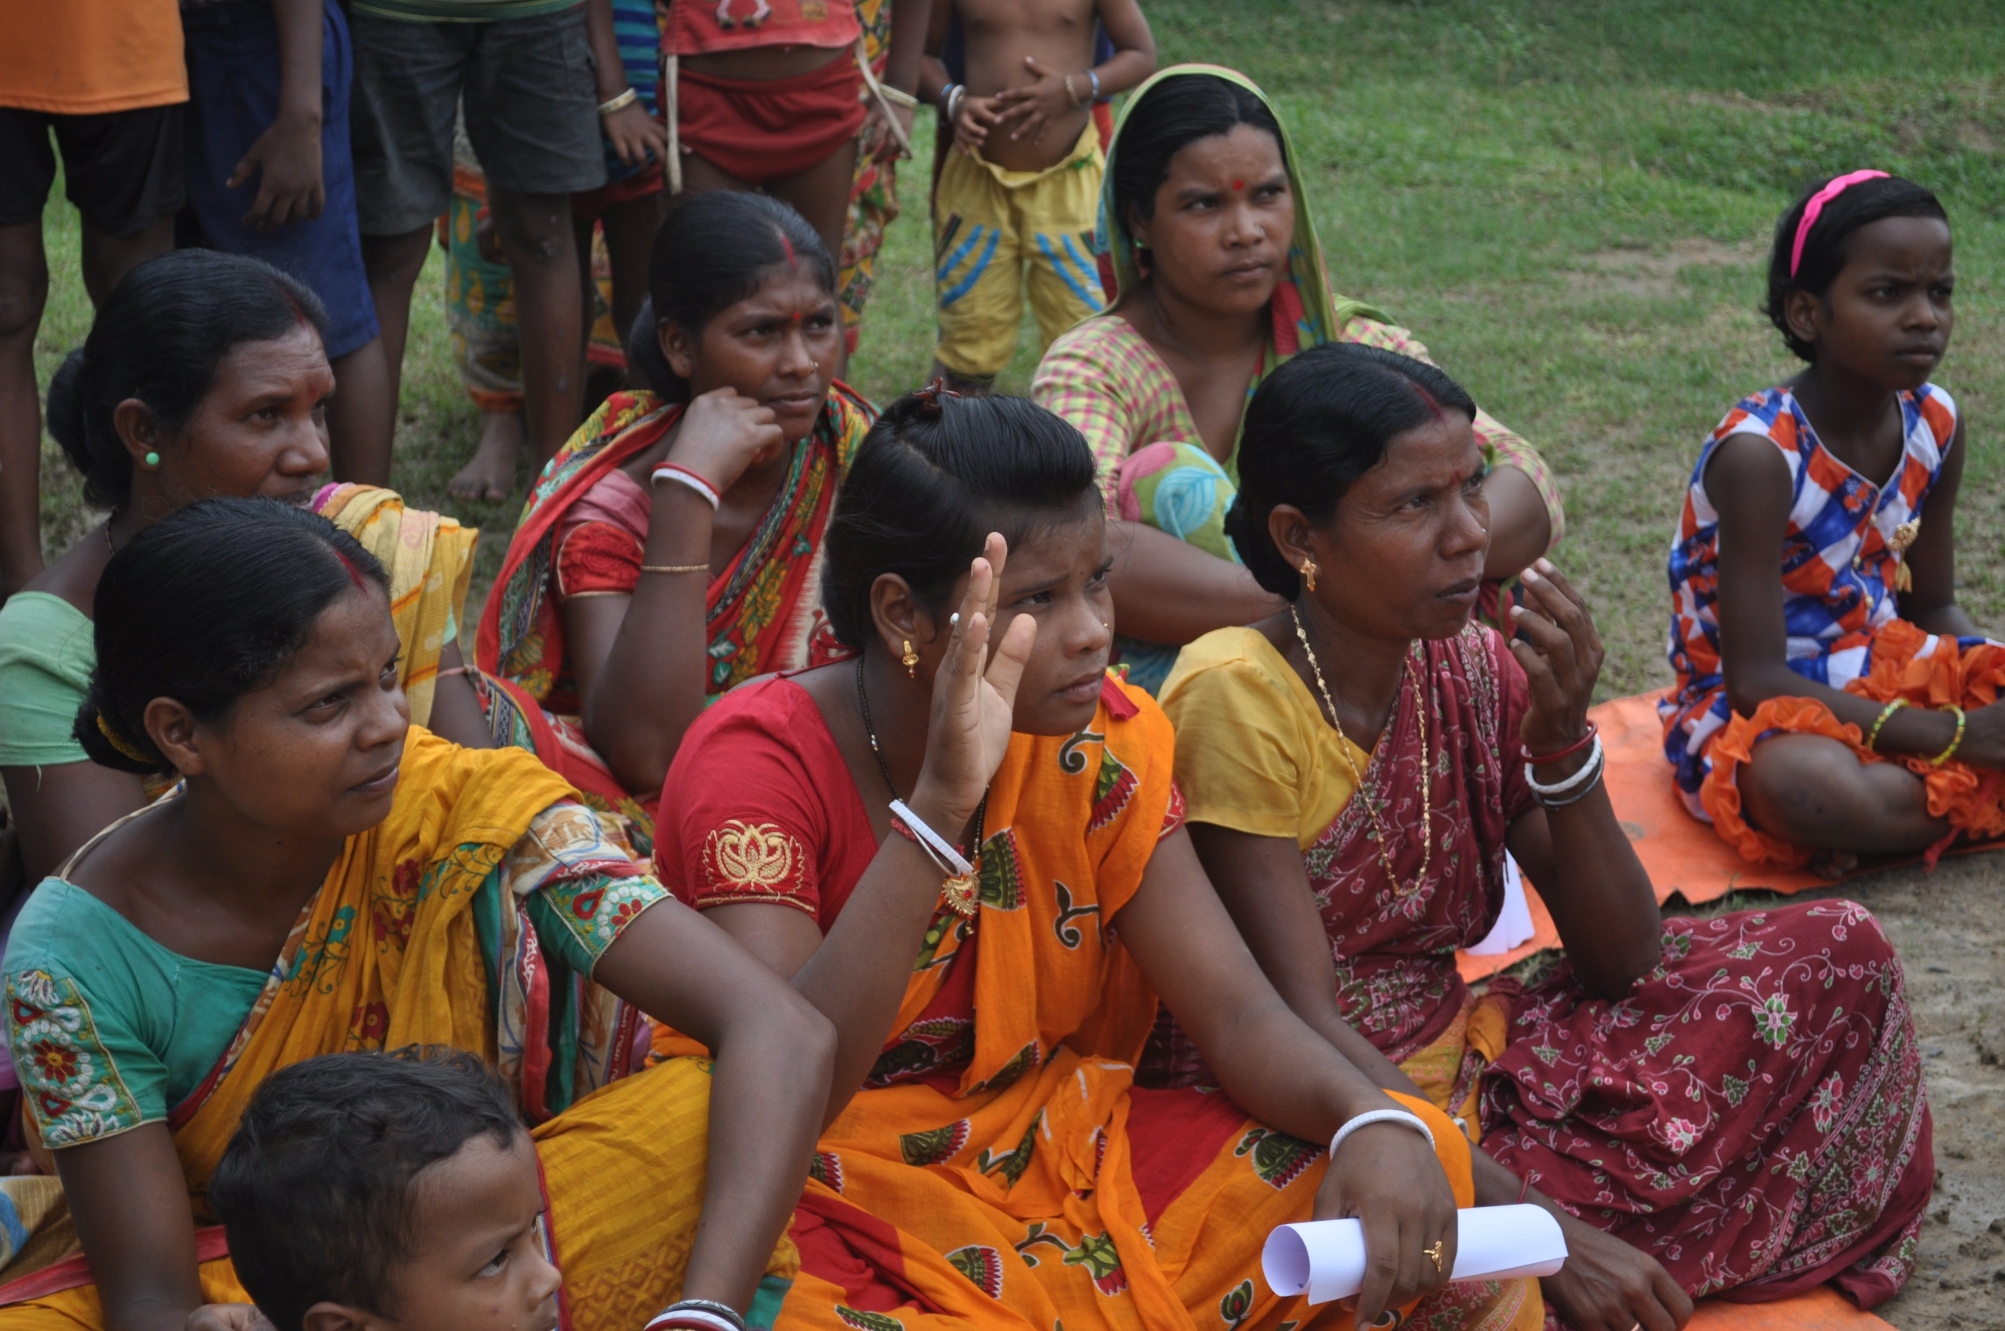
Any questions???

Slide 8
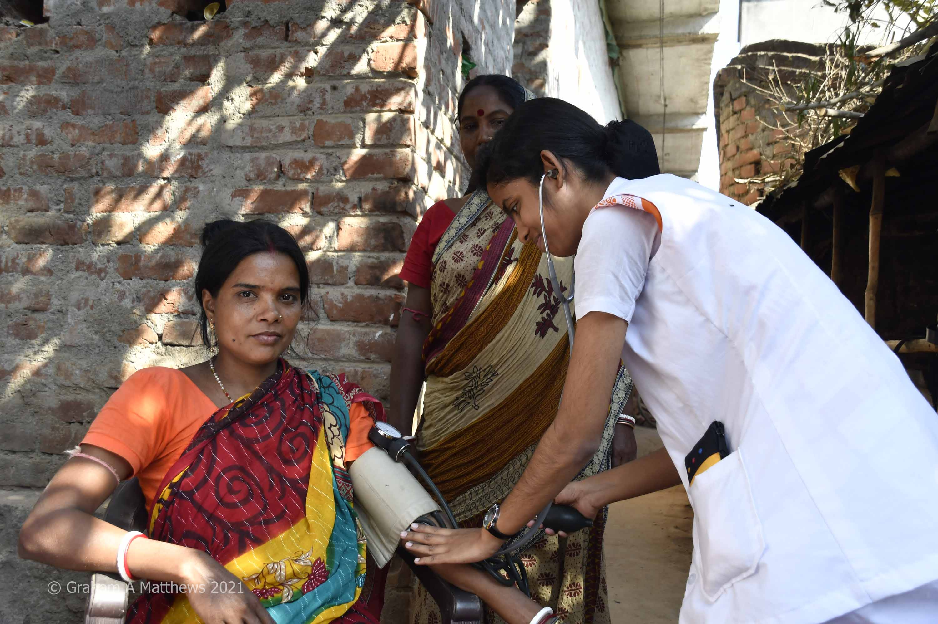
Community health checks

Slide 10
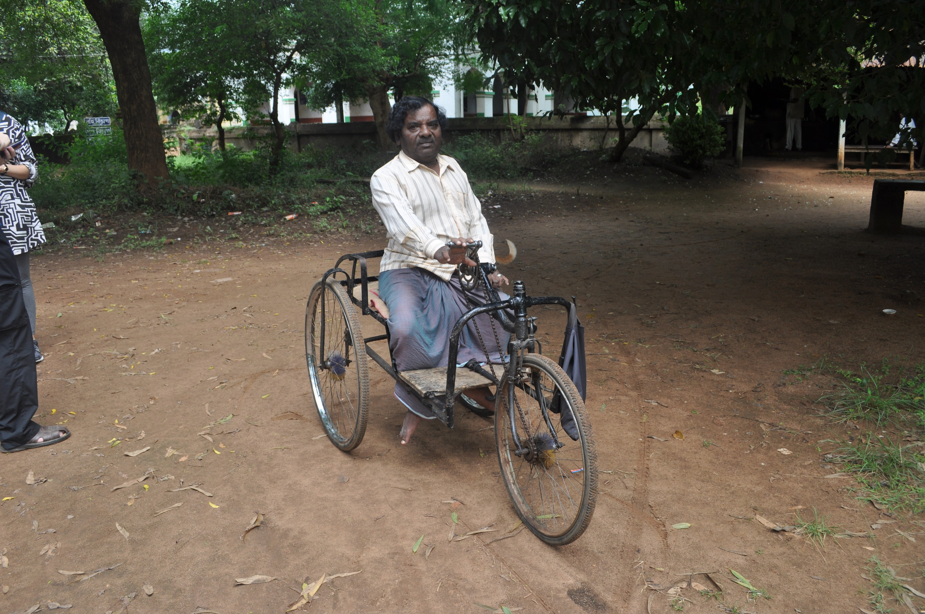
Local disability campaigner at KSN

Slide 11
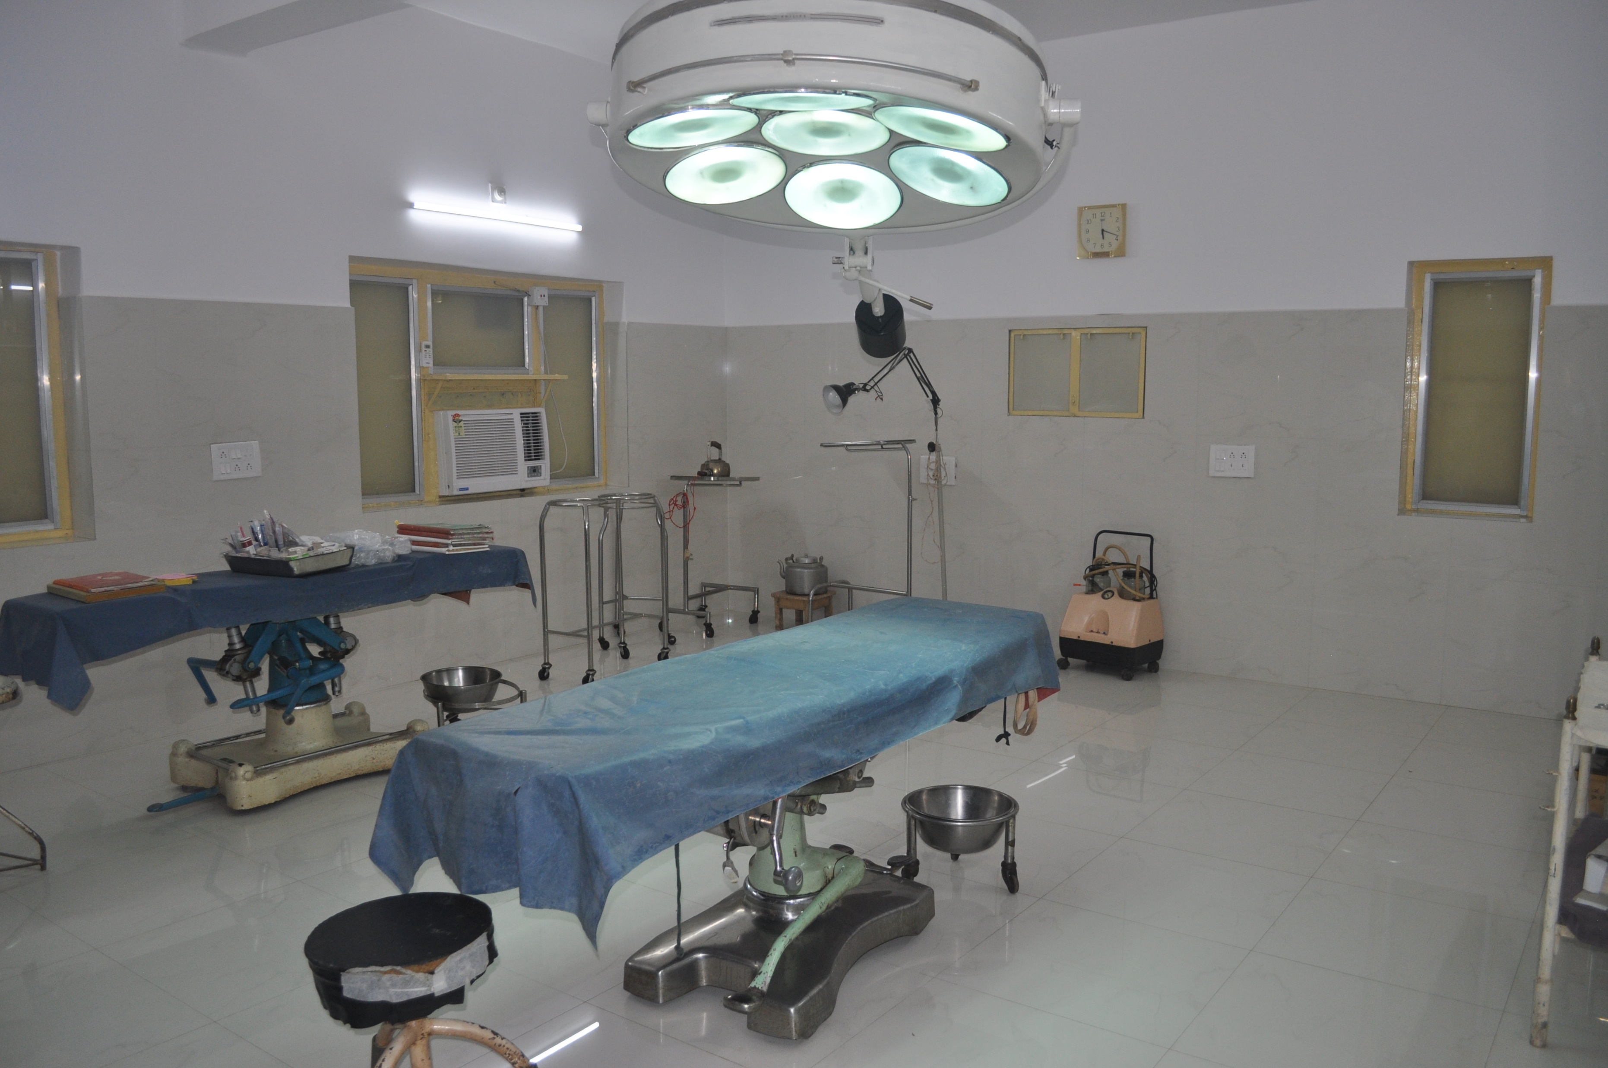
Refurbished
Operating Theatre

Slide 12
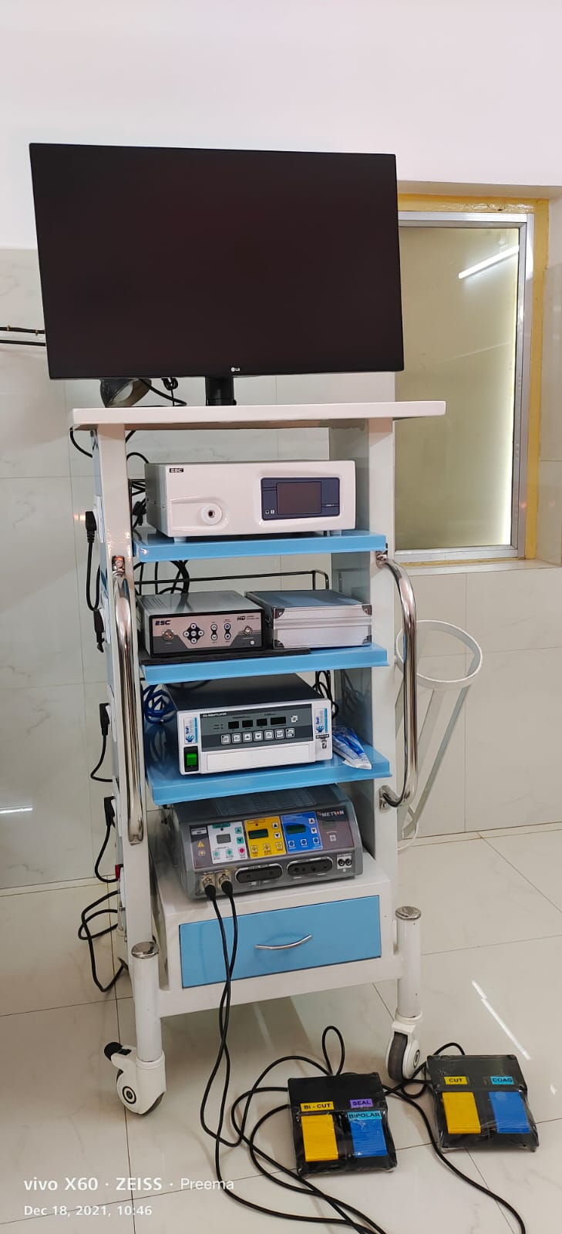
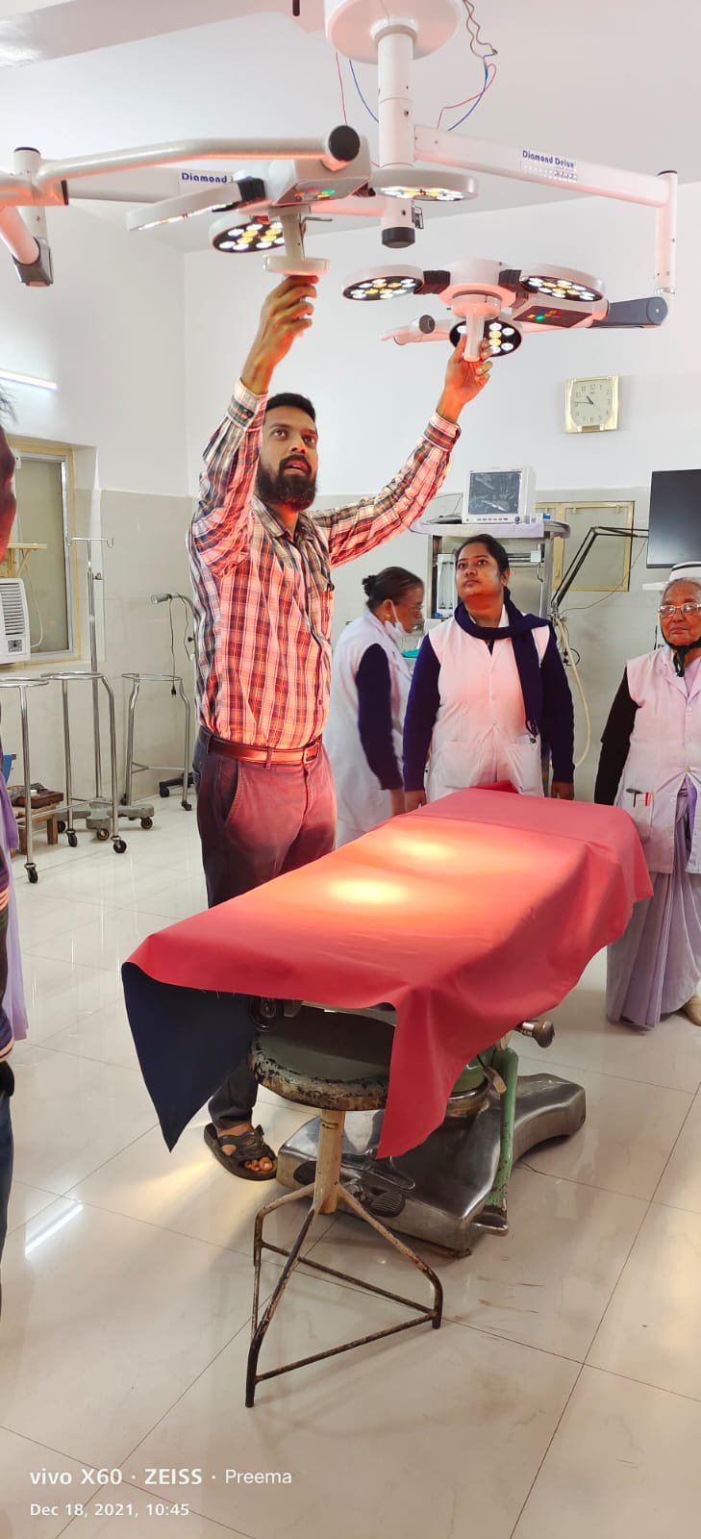
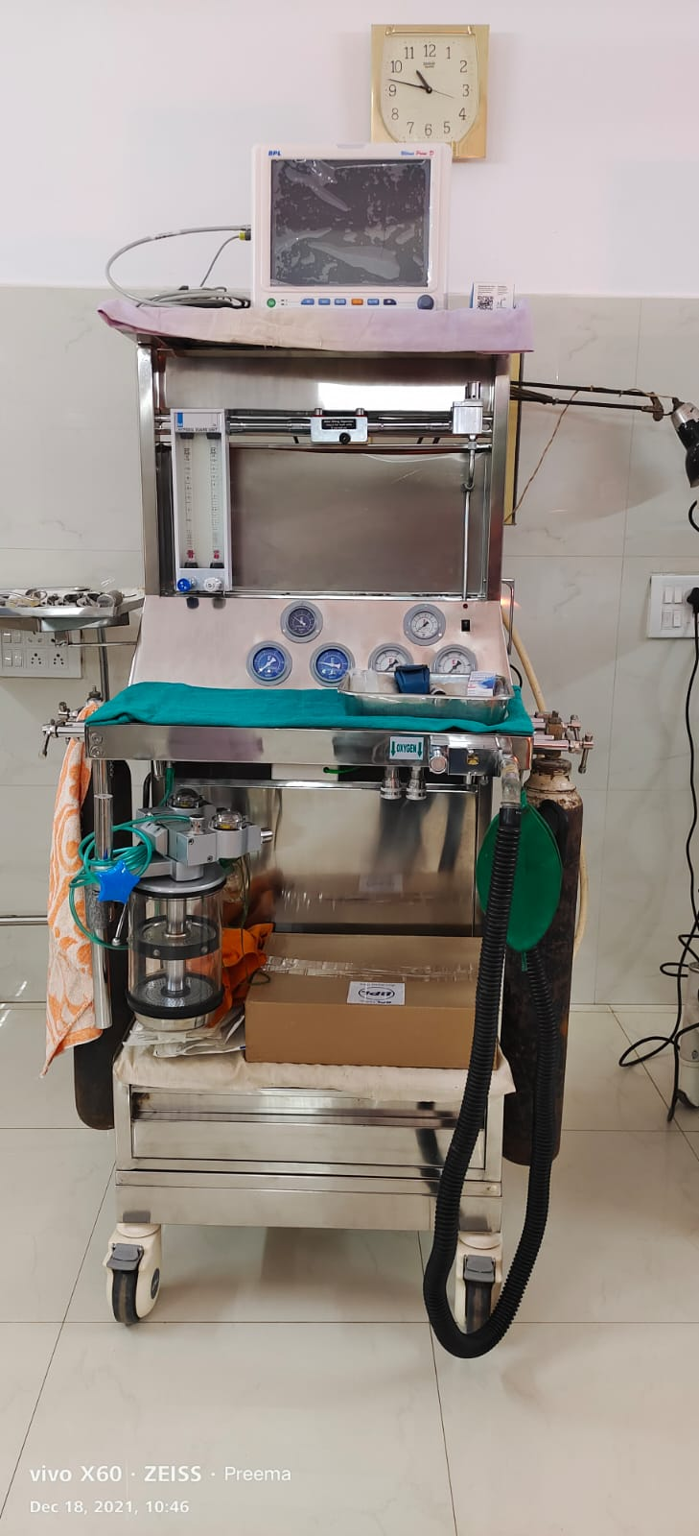
New
Operating Theatre equipment

Slide 13
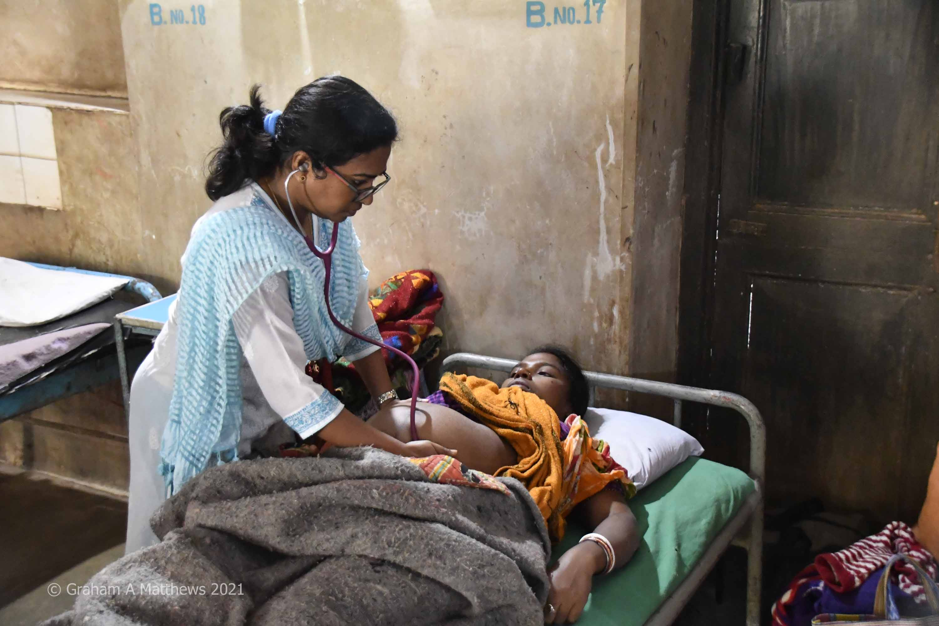
Wards still need refurbishment

Slide 15
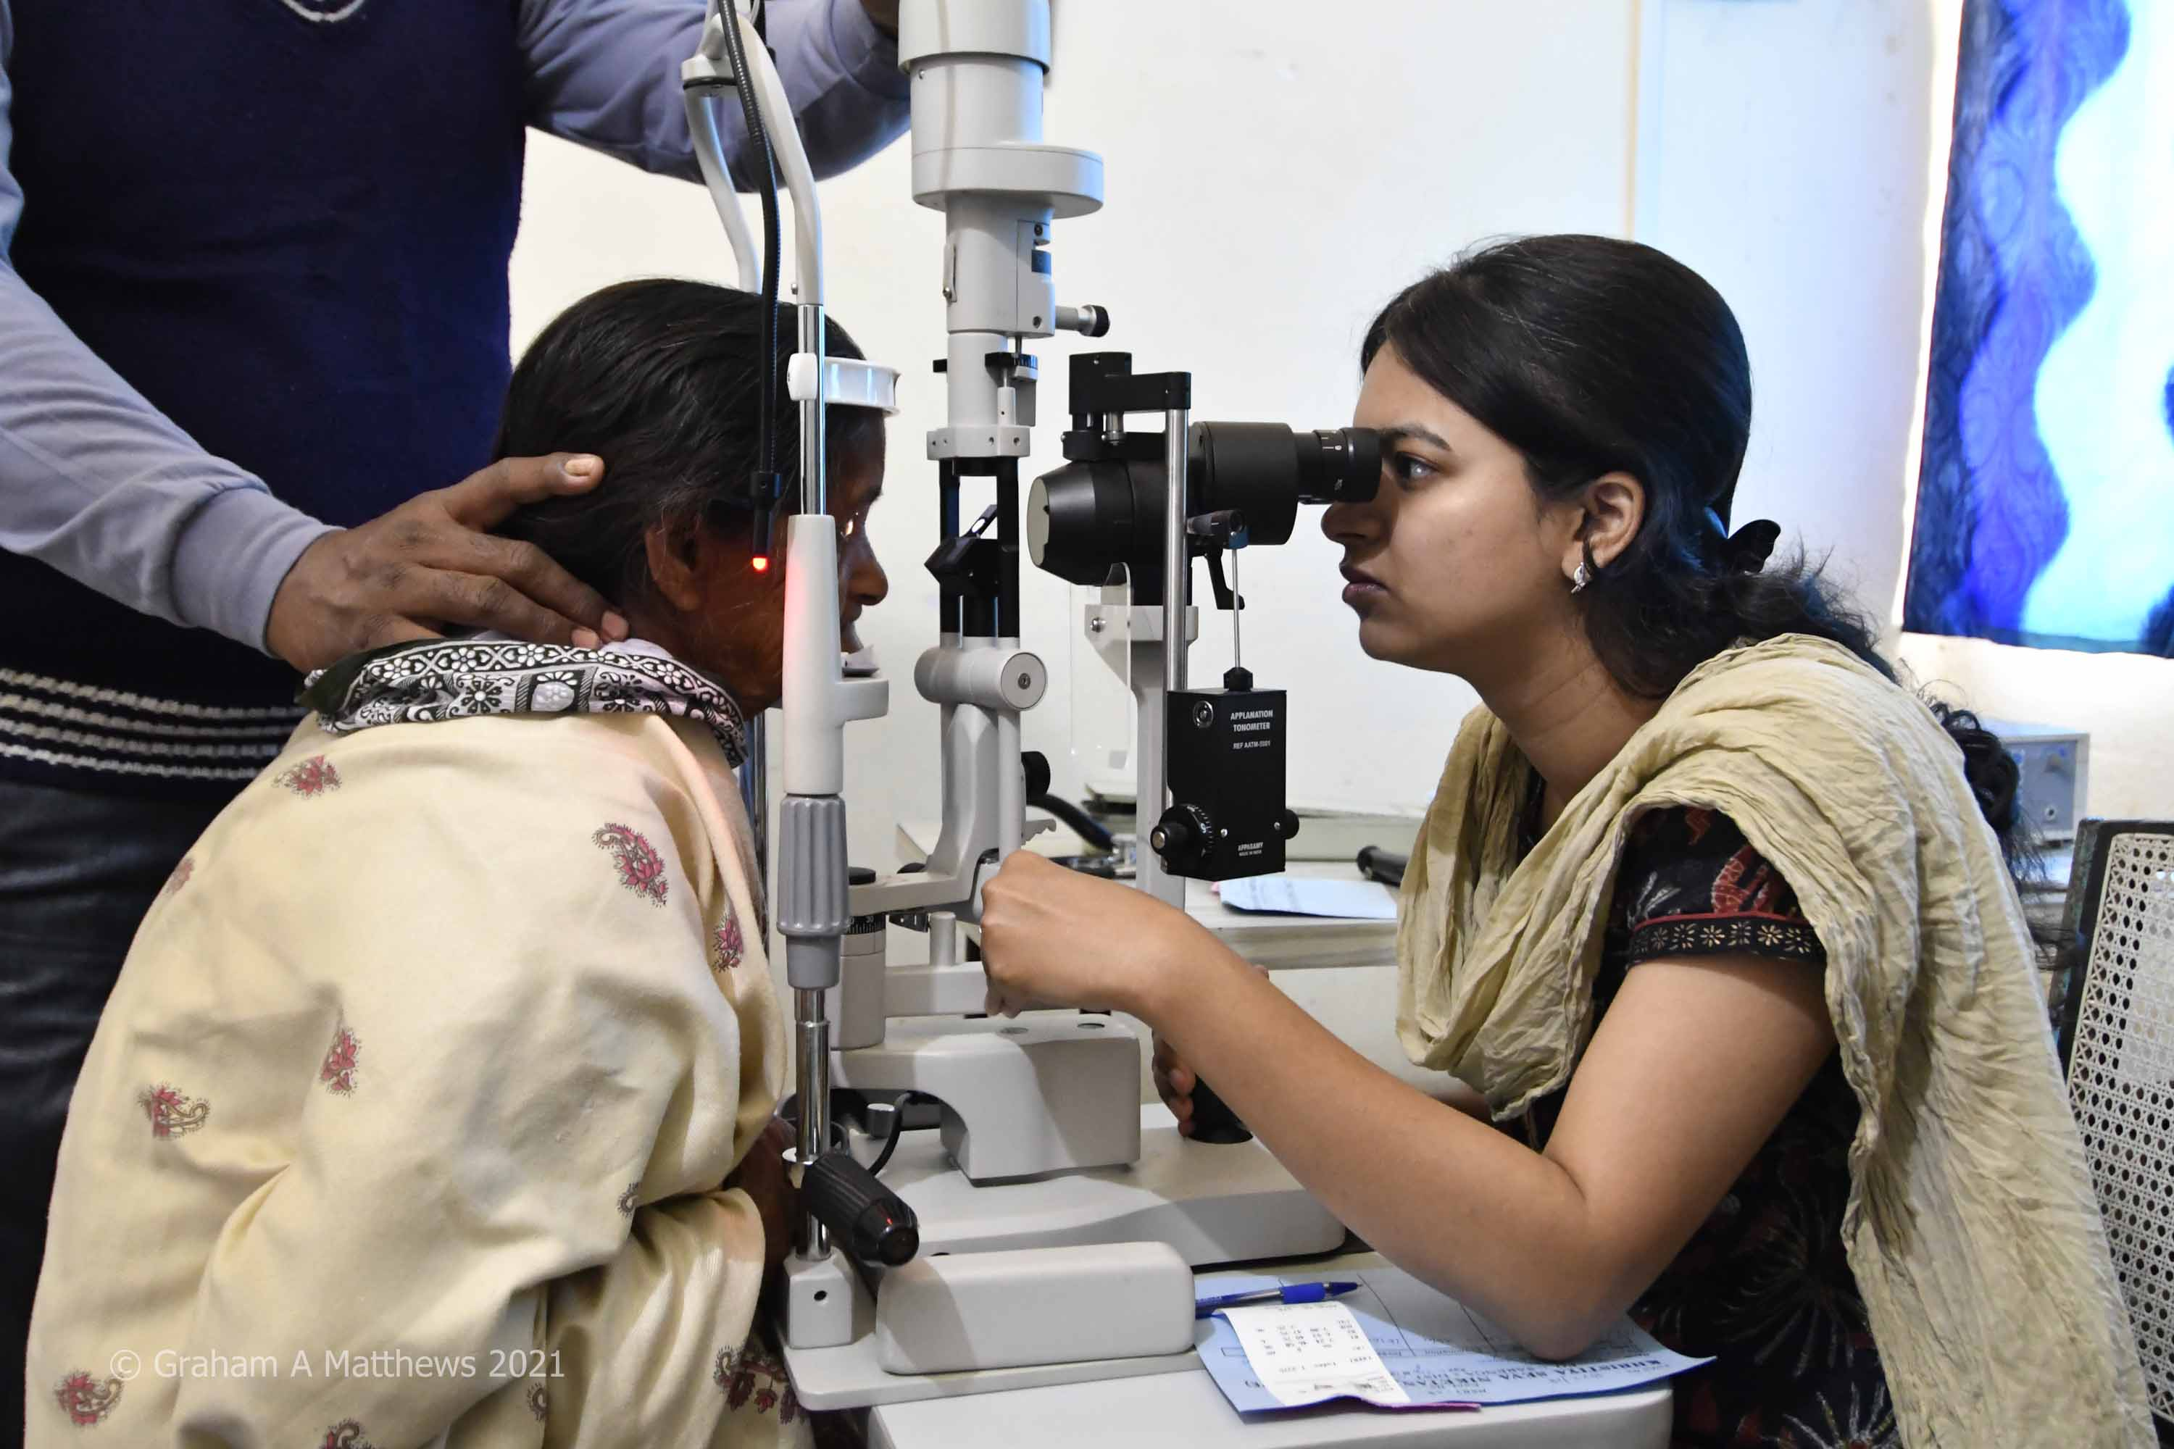
Patient assessment for cataract surgery

Slide 16
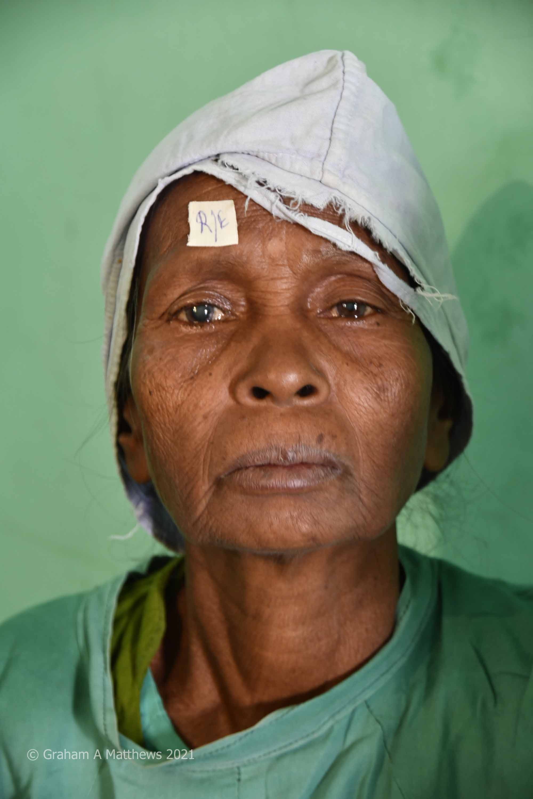
Patient ready for eye surgery

Slide 17
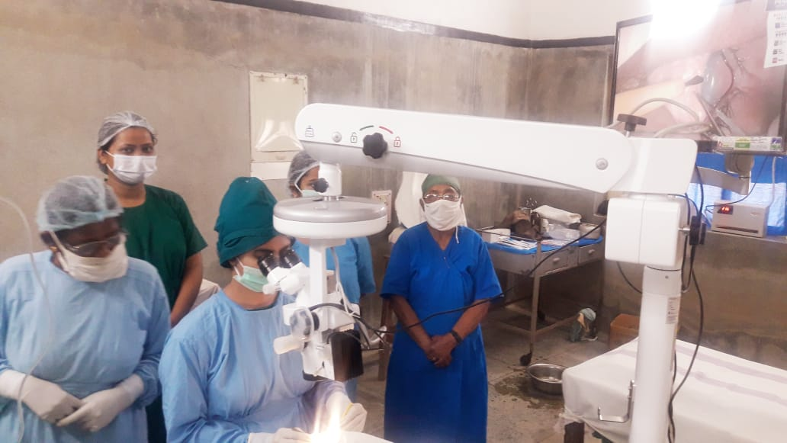
New operating microscope in second operating theatre…

Slide 18
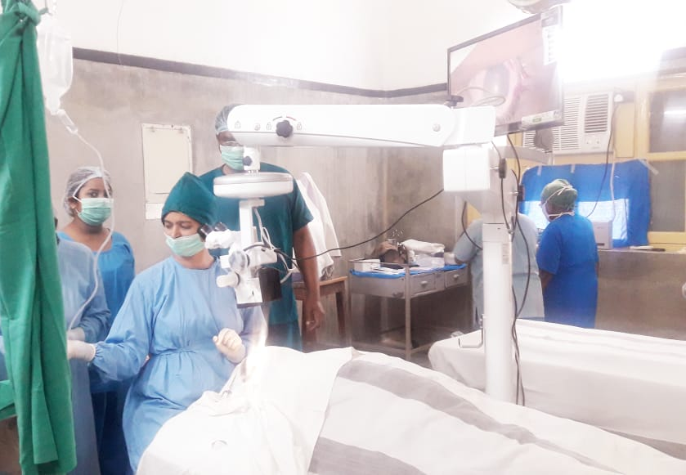
…which still needs refurbishment

Slide 19
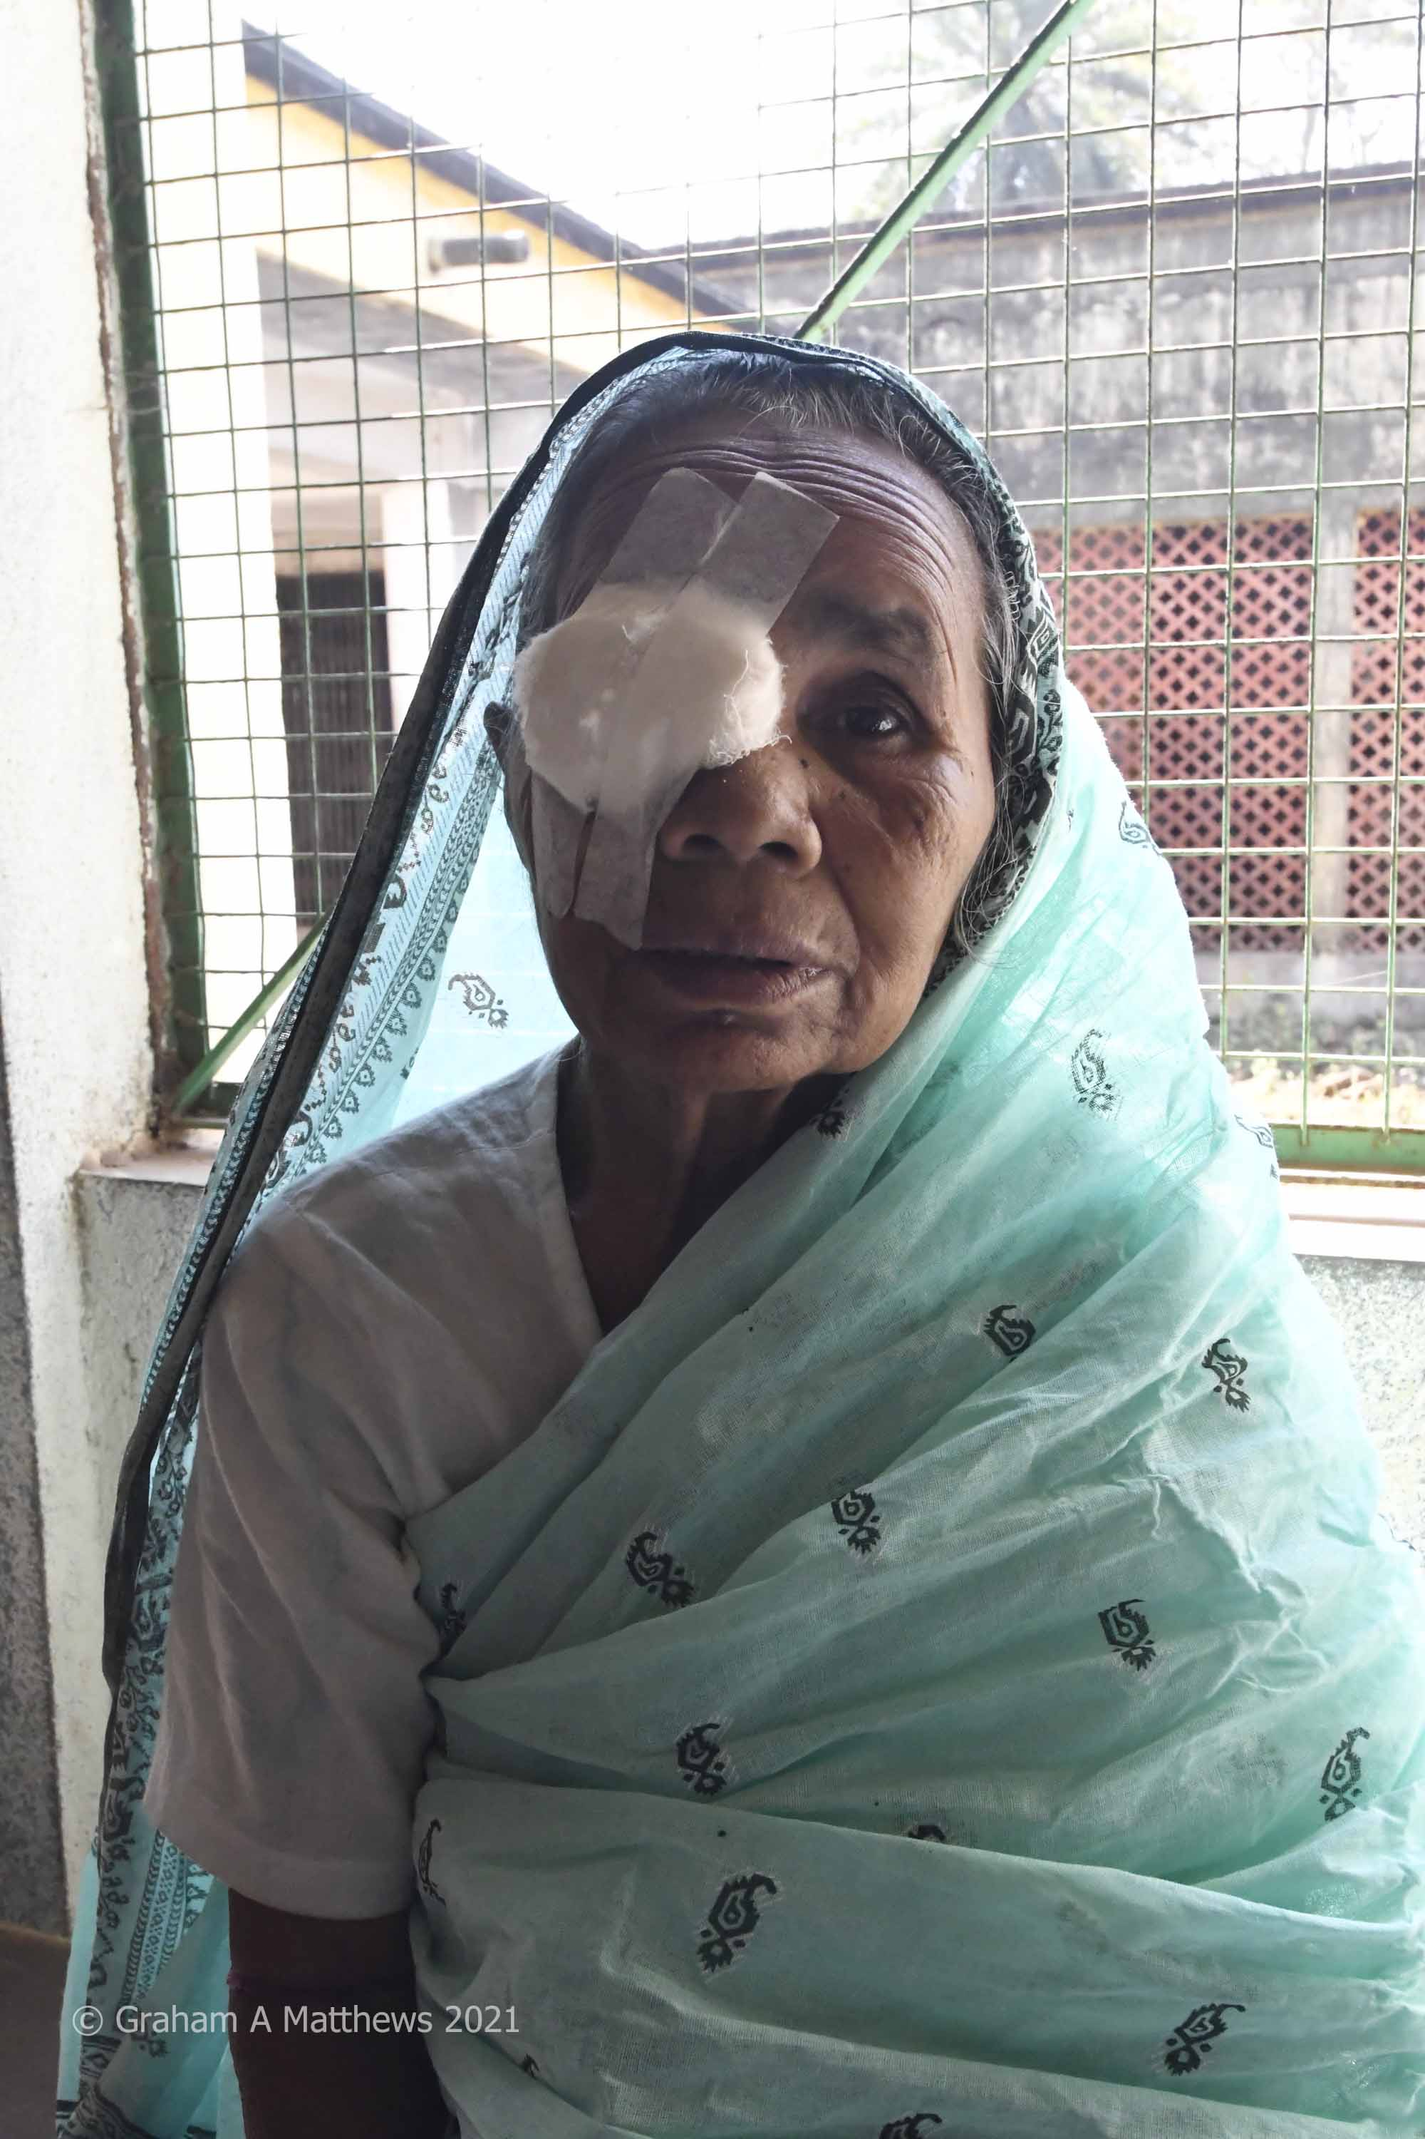
Post operation

Slide 20
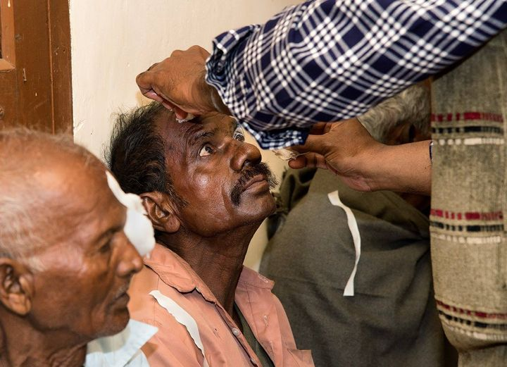
Bandages removed after cataract surgery

Slide 21
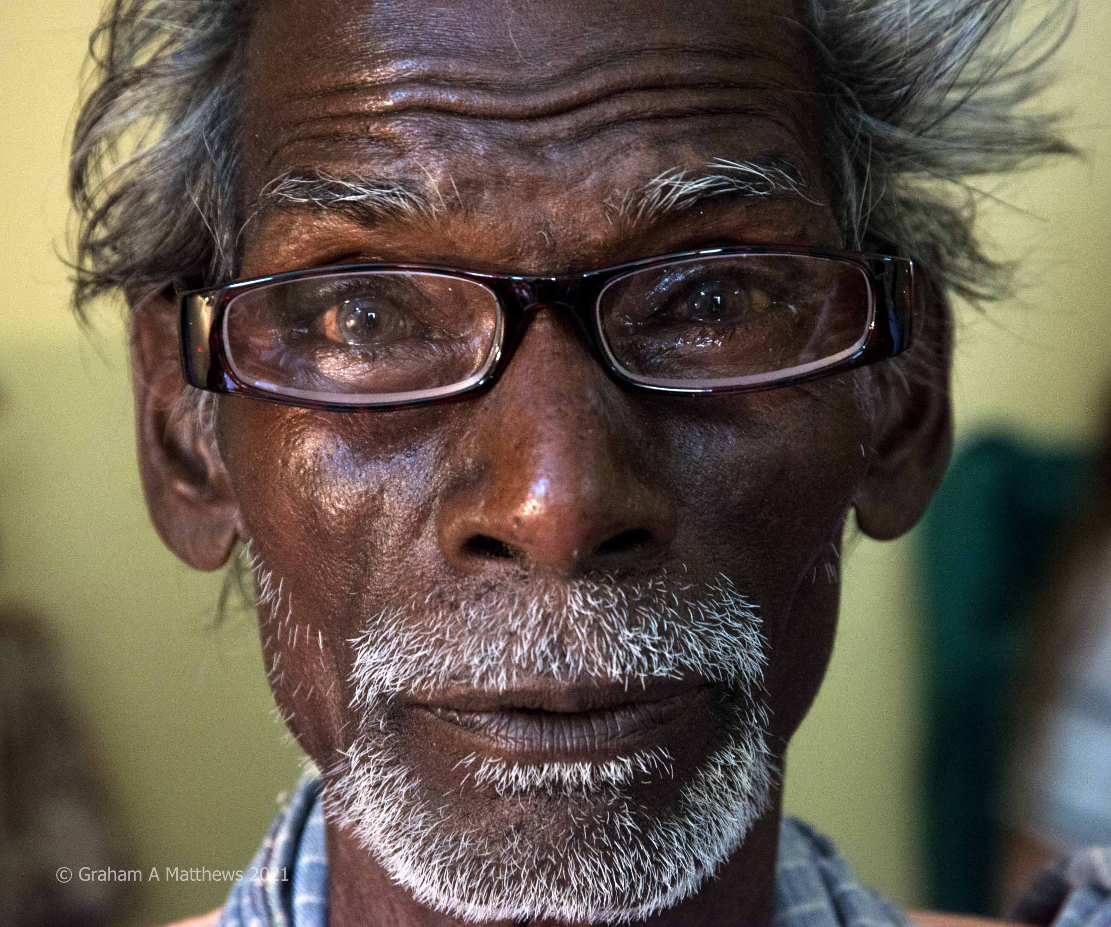
New glasses fitted

Slide 22
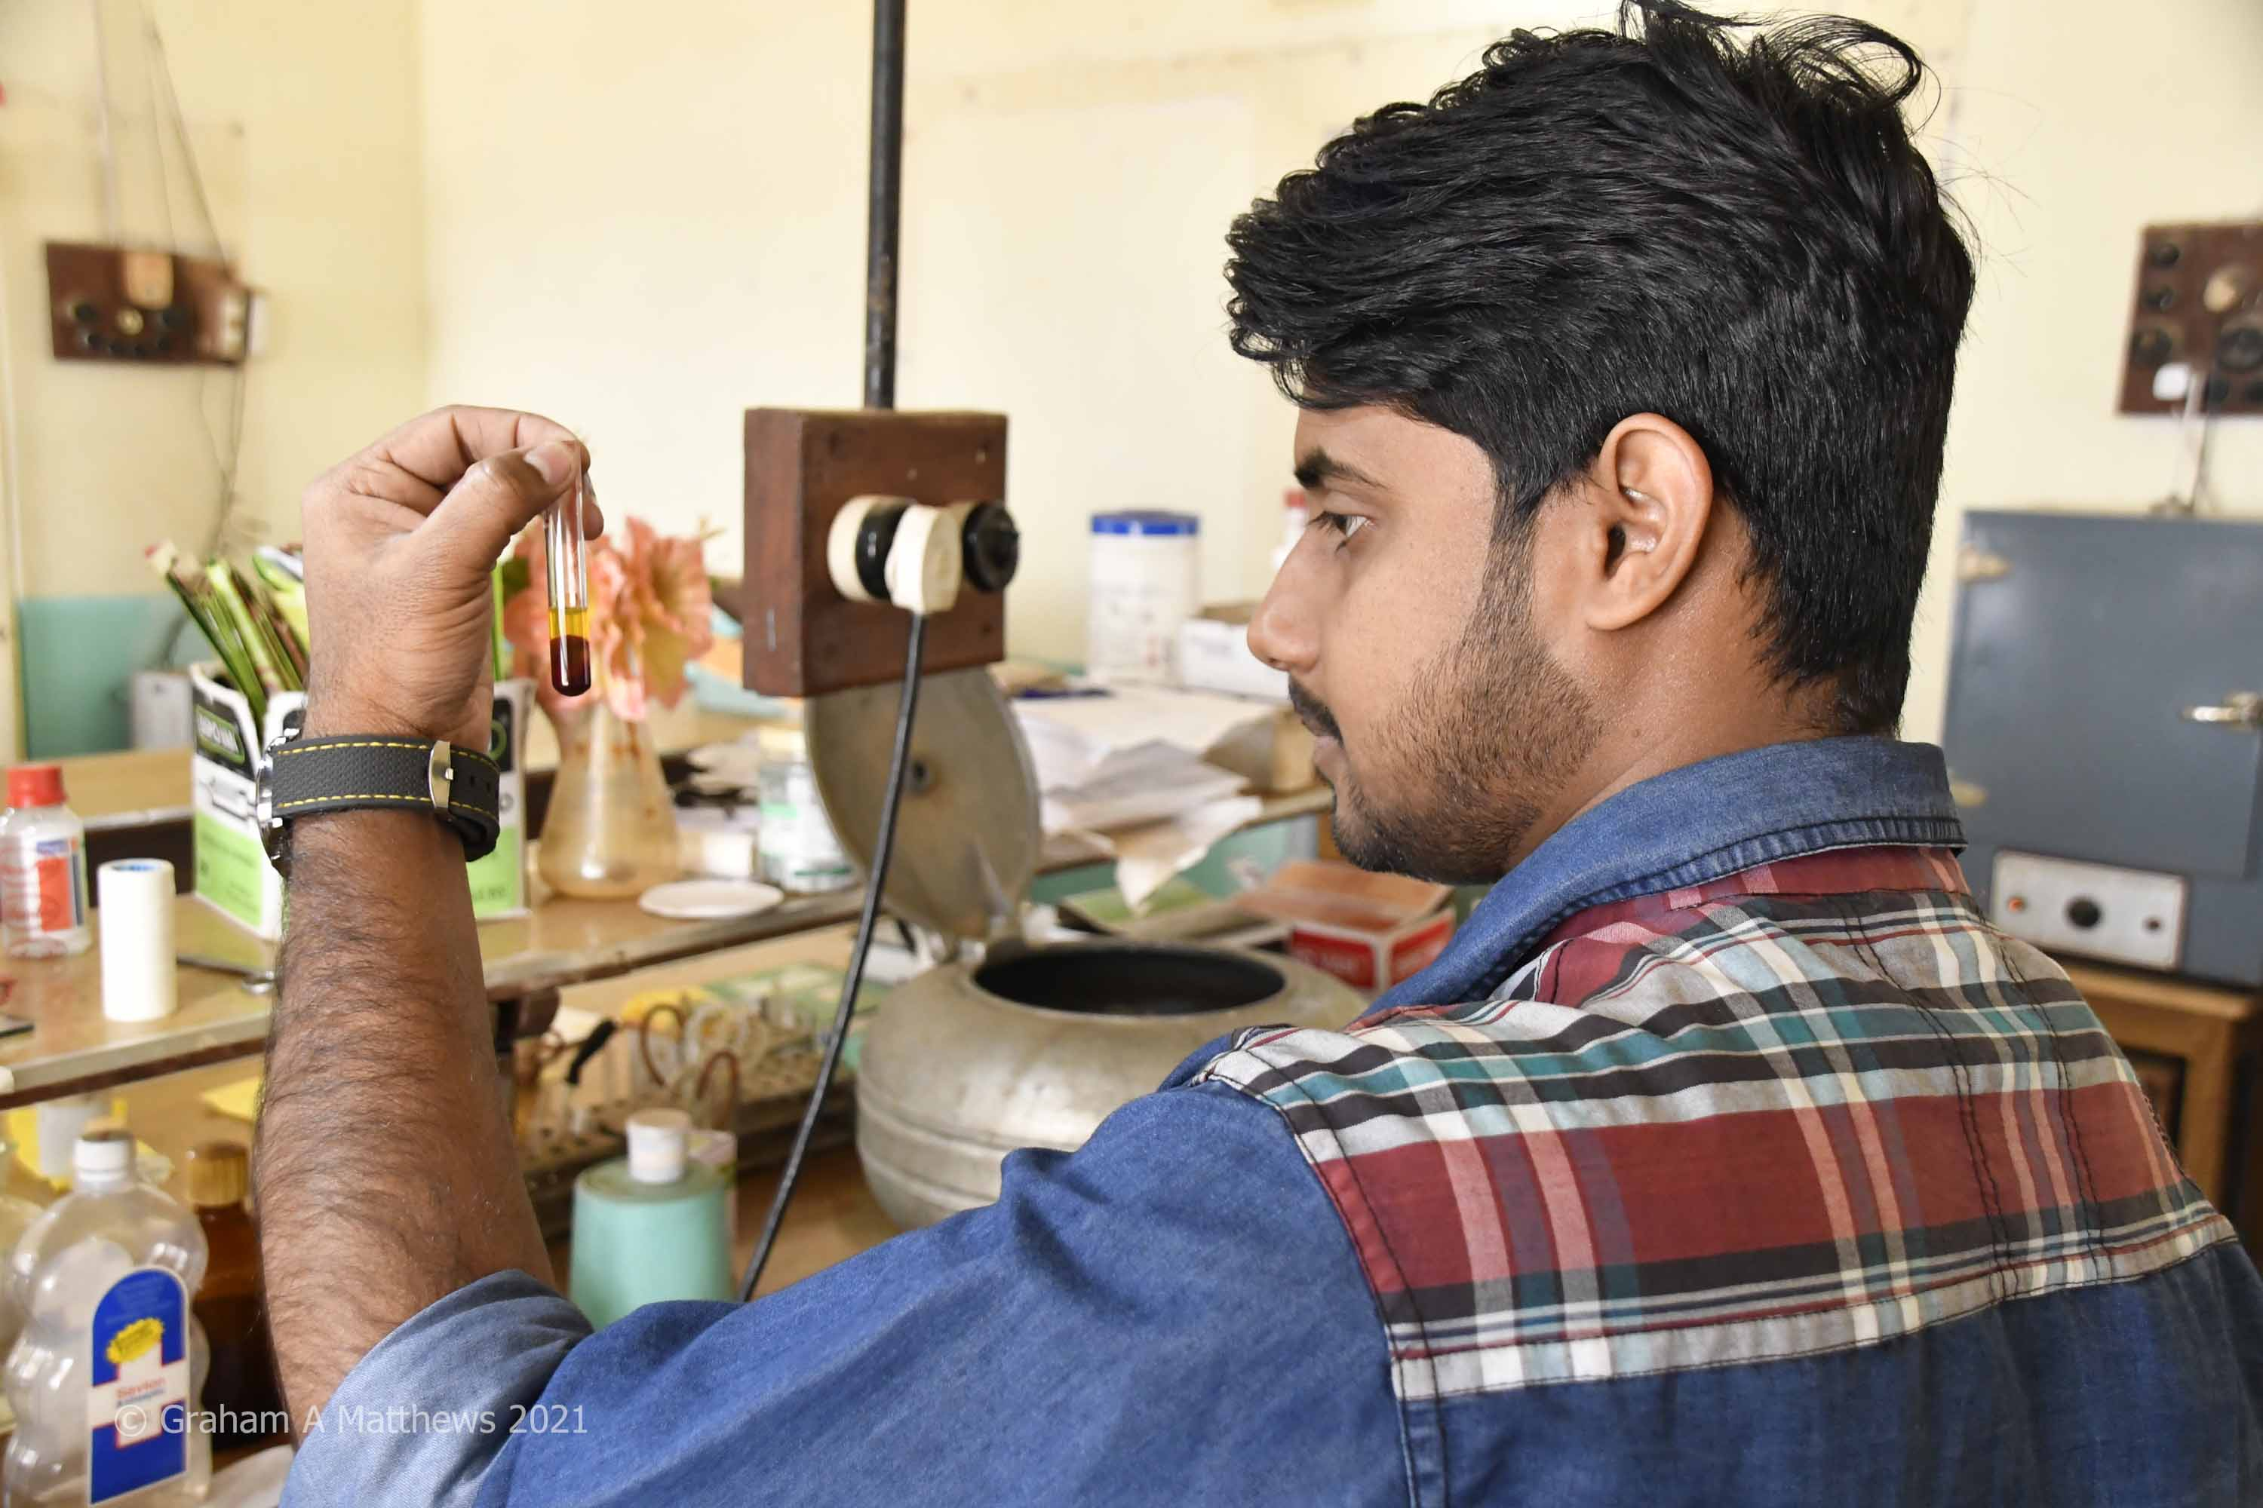
Laboratory investigations before…

Slide 23
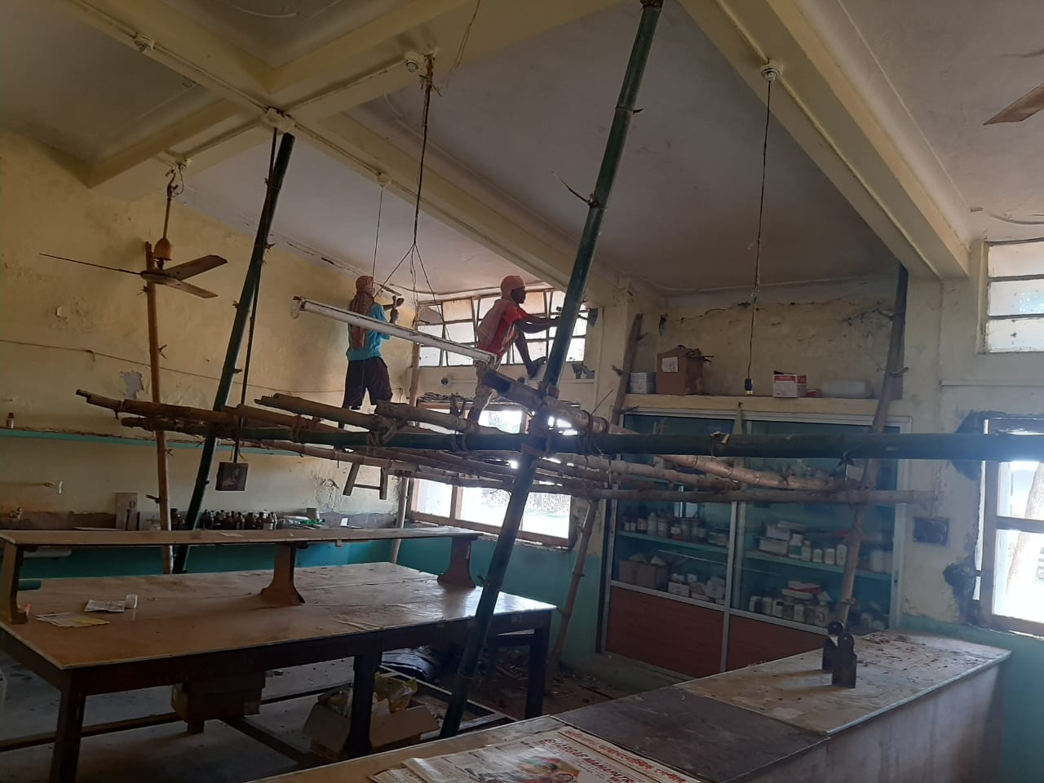
…laboratory refurbishment work…
…inside

Slide 24
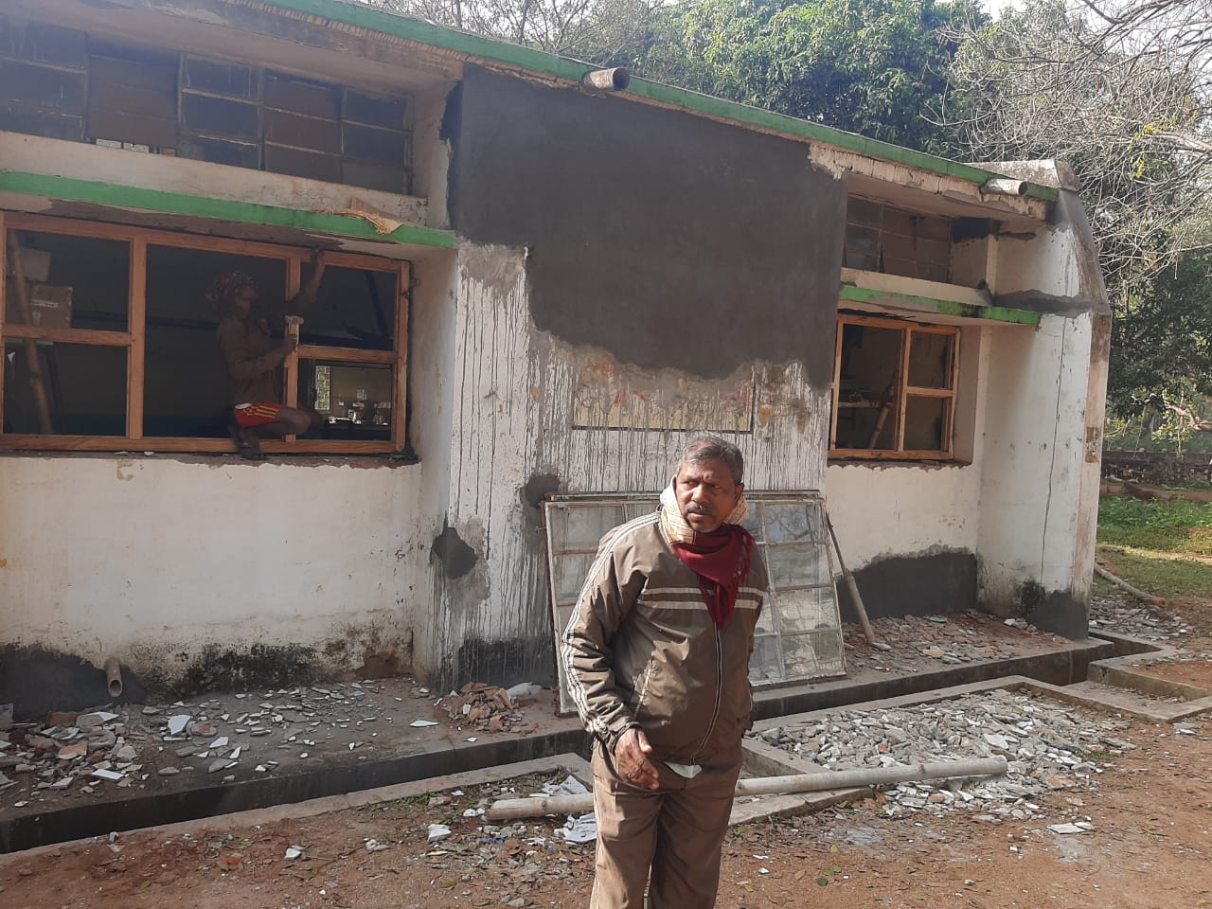
…and out

Slide 25
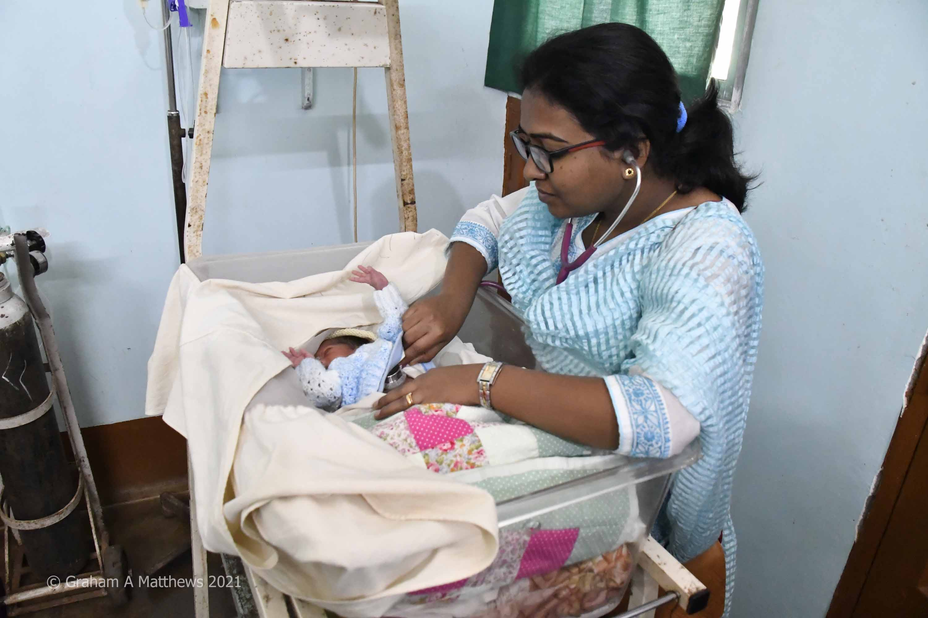
Checking out a new arrival…

Slide 26
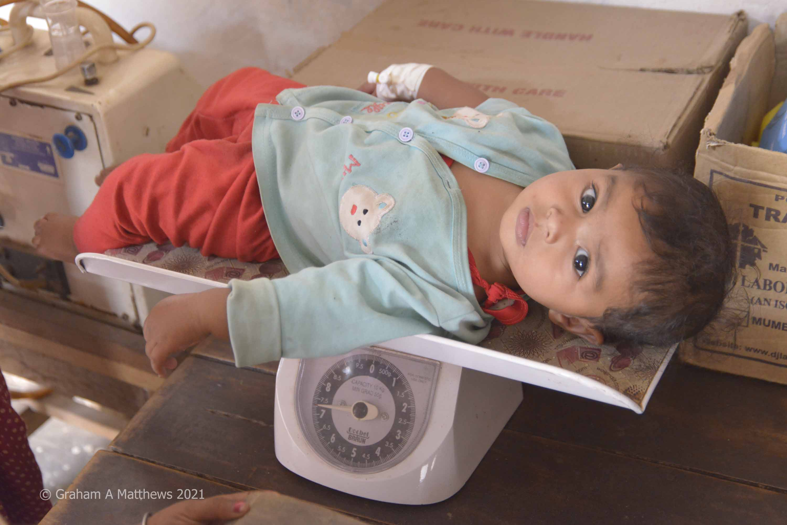
…and an older baby’s development

Slide 27
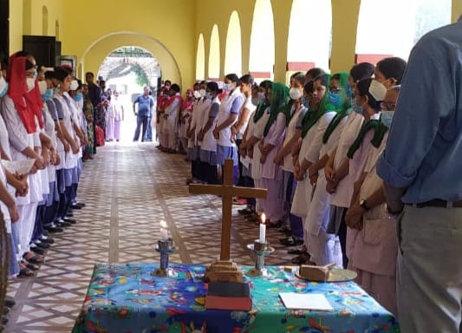
Prayers are held each day – one day a week on a ward

Slide 28
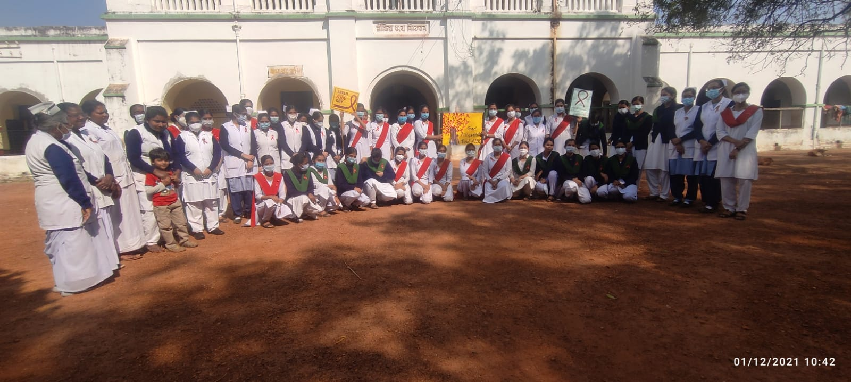
Hospital Nursing Staff and Nurses Training School marking World AIDS Day

Slide 29
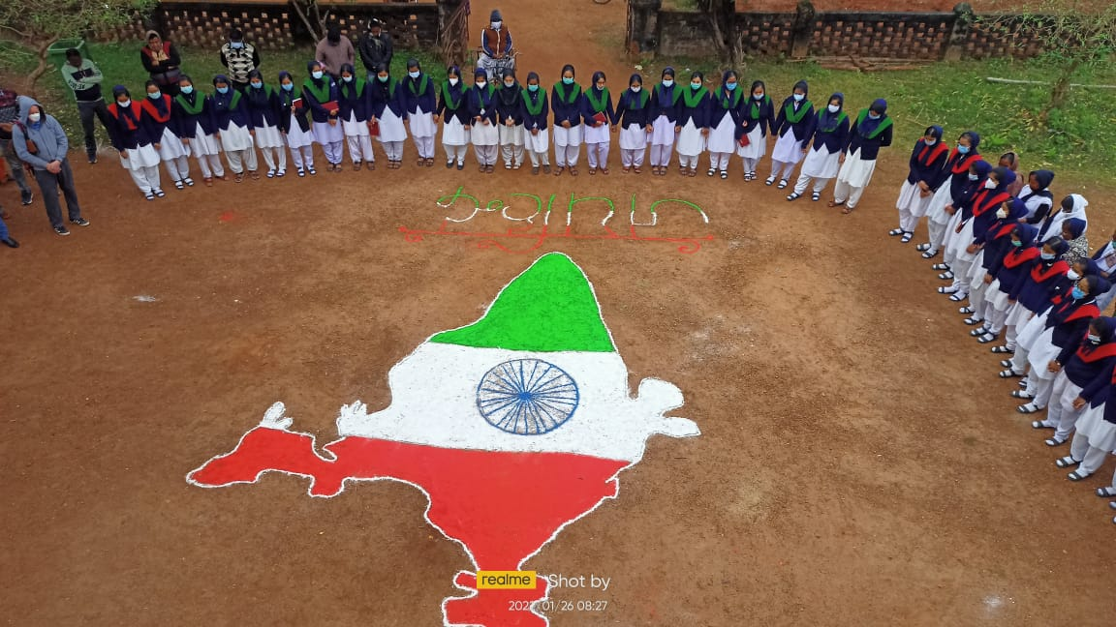
Hospital Nursing Staff and Nurses Training School marking India Republic Day

Slide 31
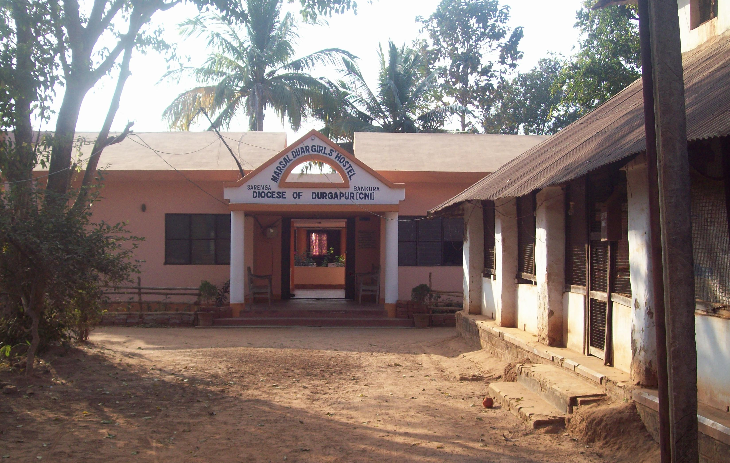
Marshal Duar girls’ hostel

Slide 32
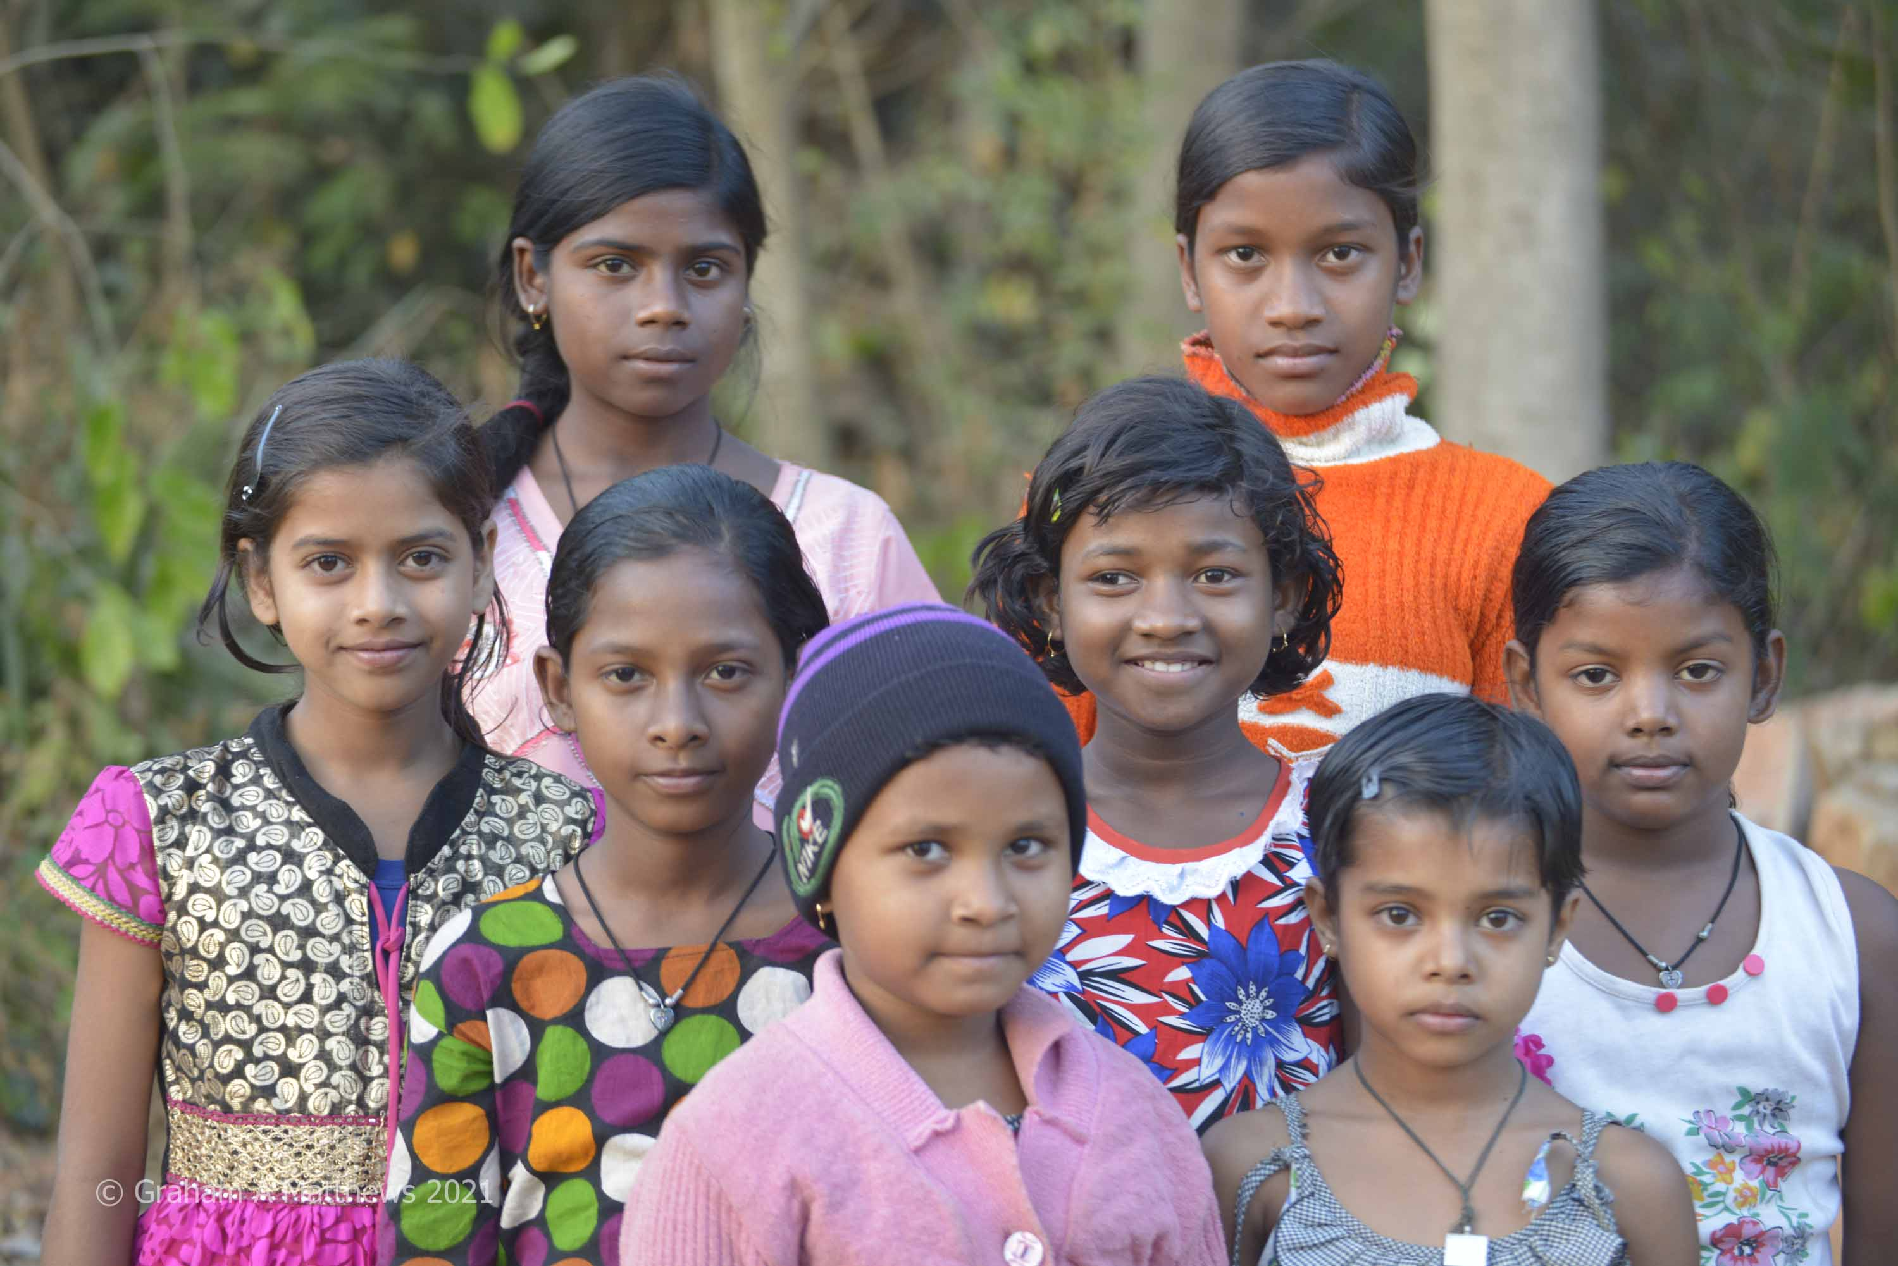
Marshal Duar residents (pre-pandemic)

Slide 33
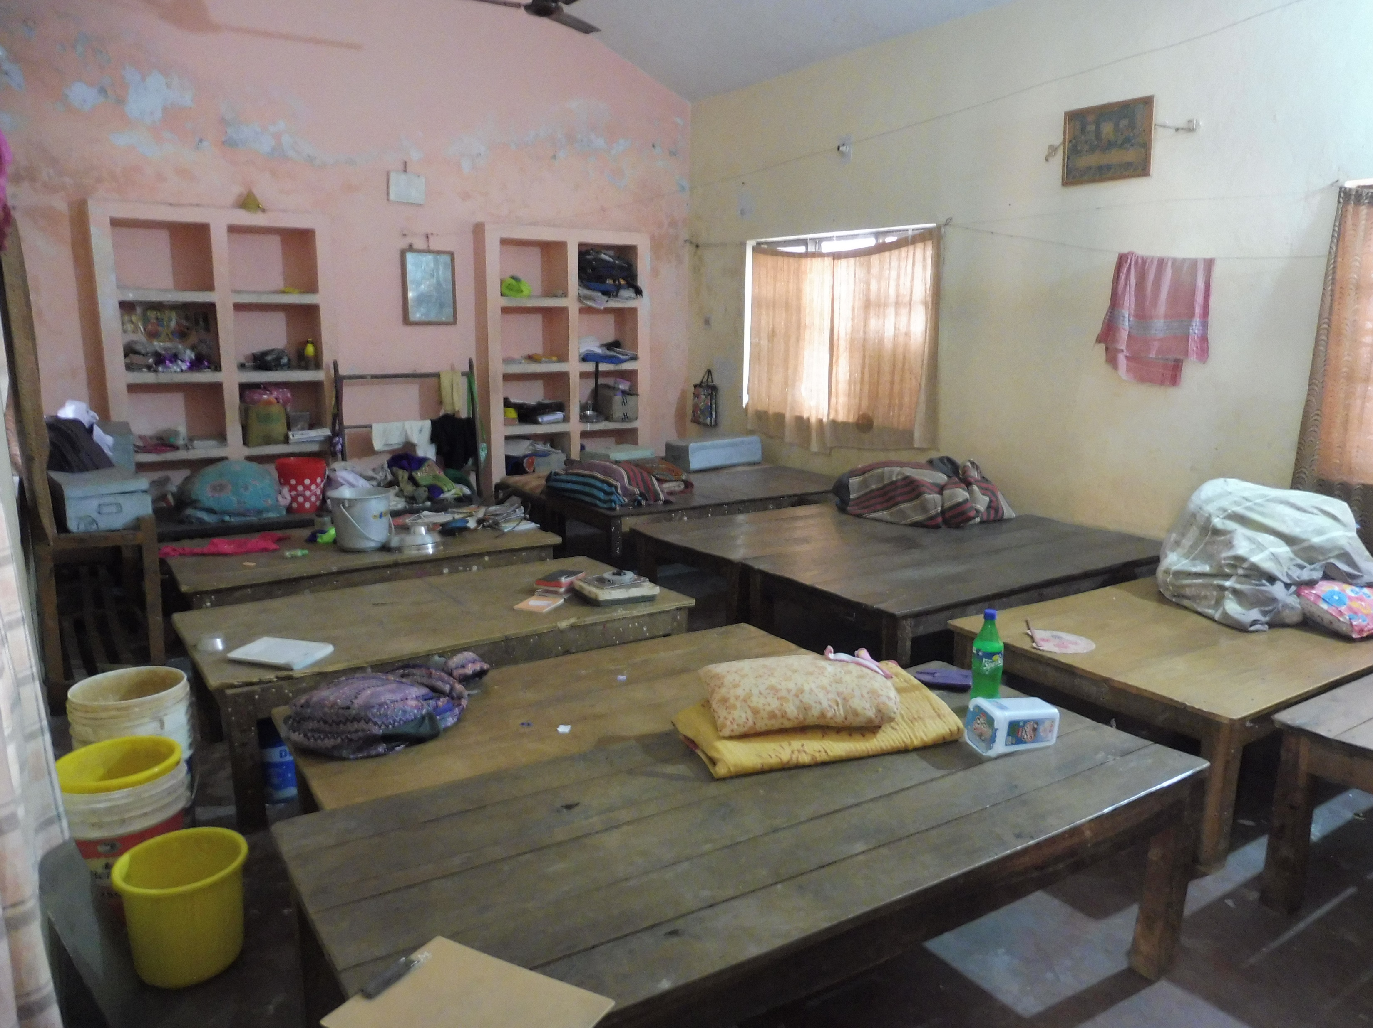
Significant work is required to bring Marshall Duar back into safe use…

Slide 34
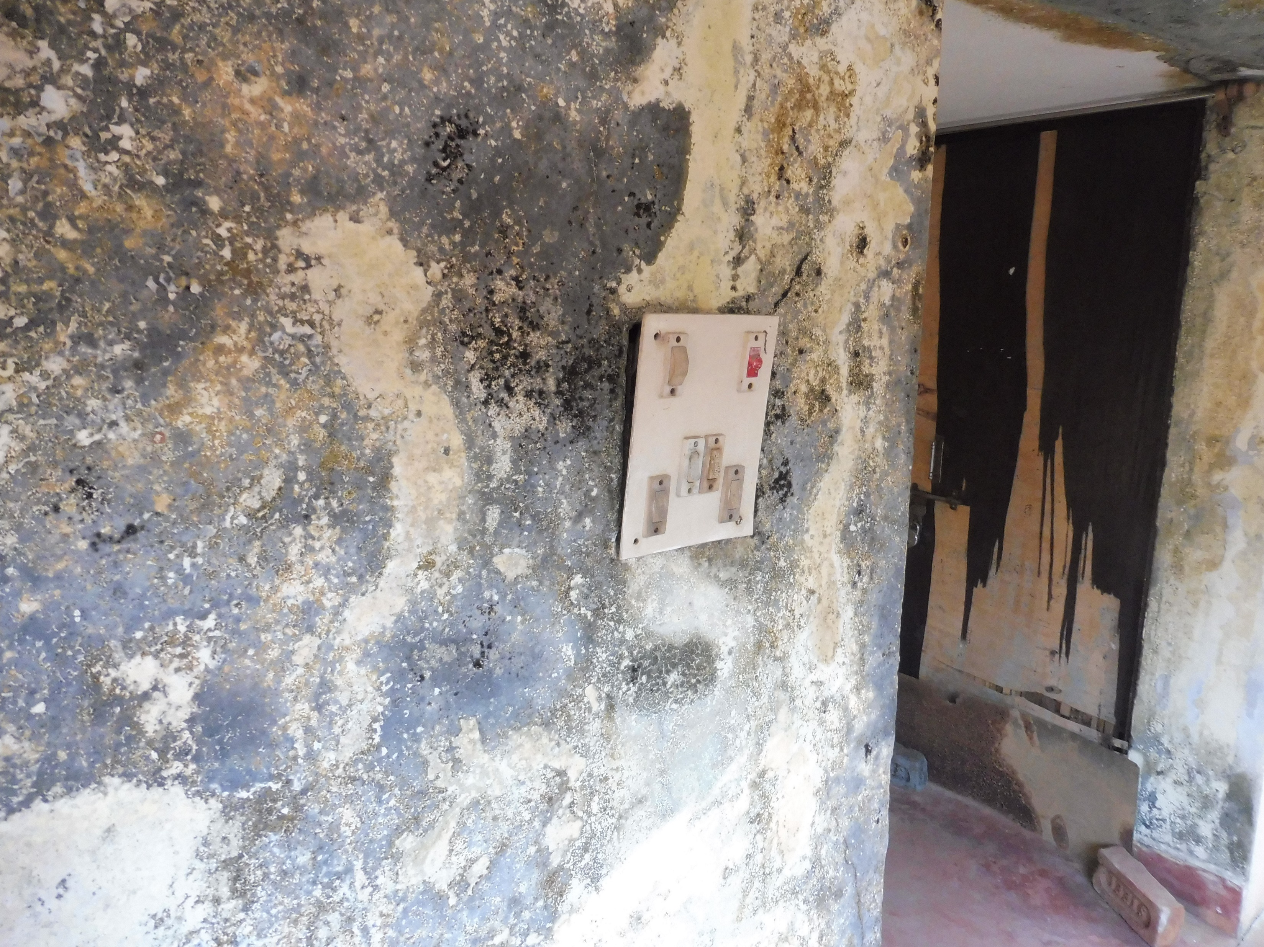
…with damp being a perennial problem

Slide 35
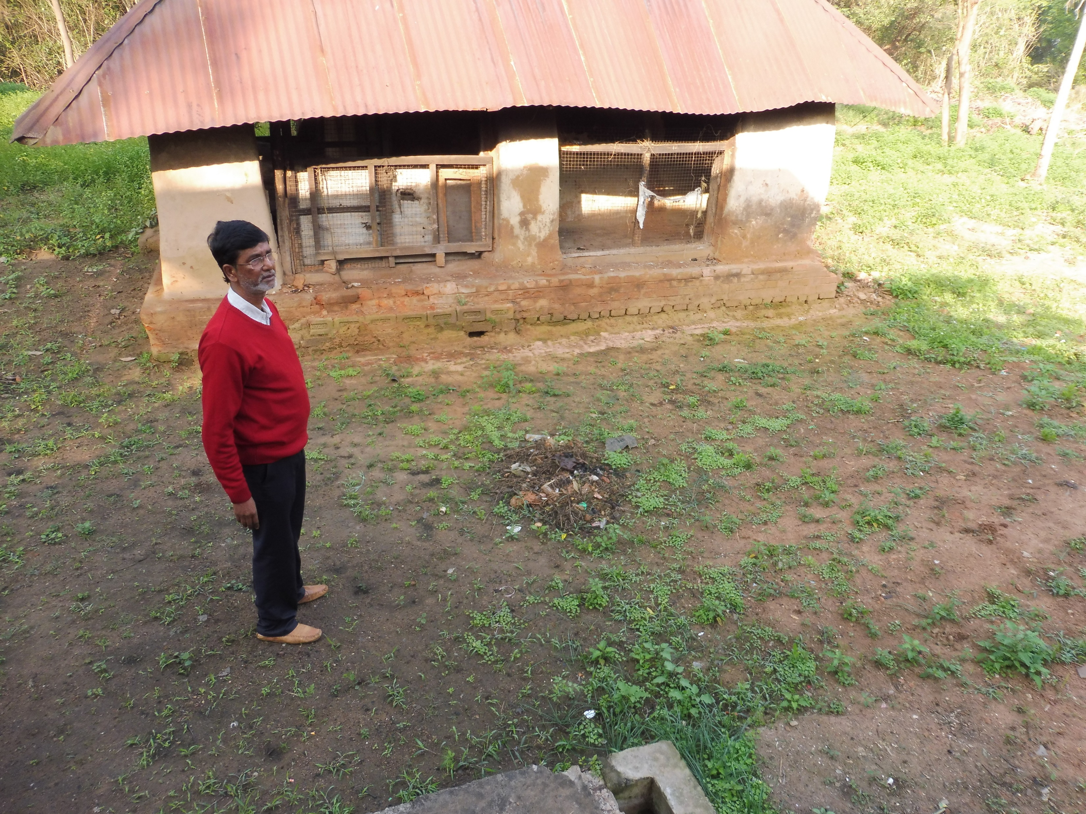
Hospital Director, Pradip Baux, stands where they’d like to build a new kitchen for the hostel…

Slide 36
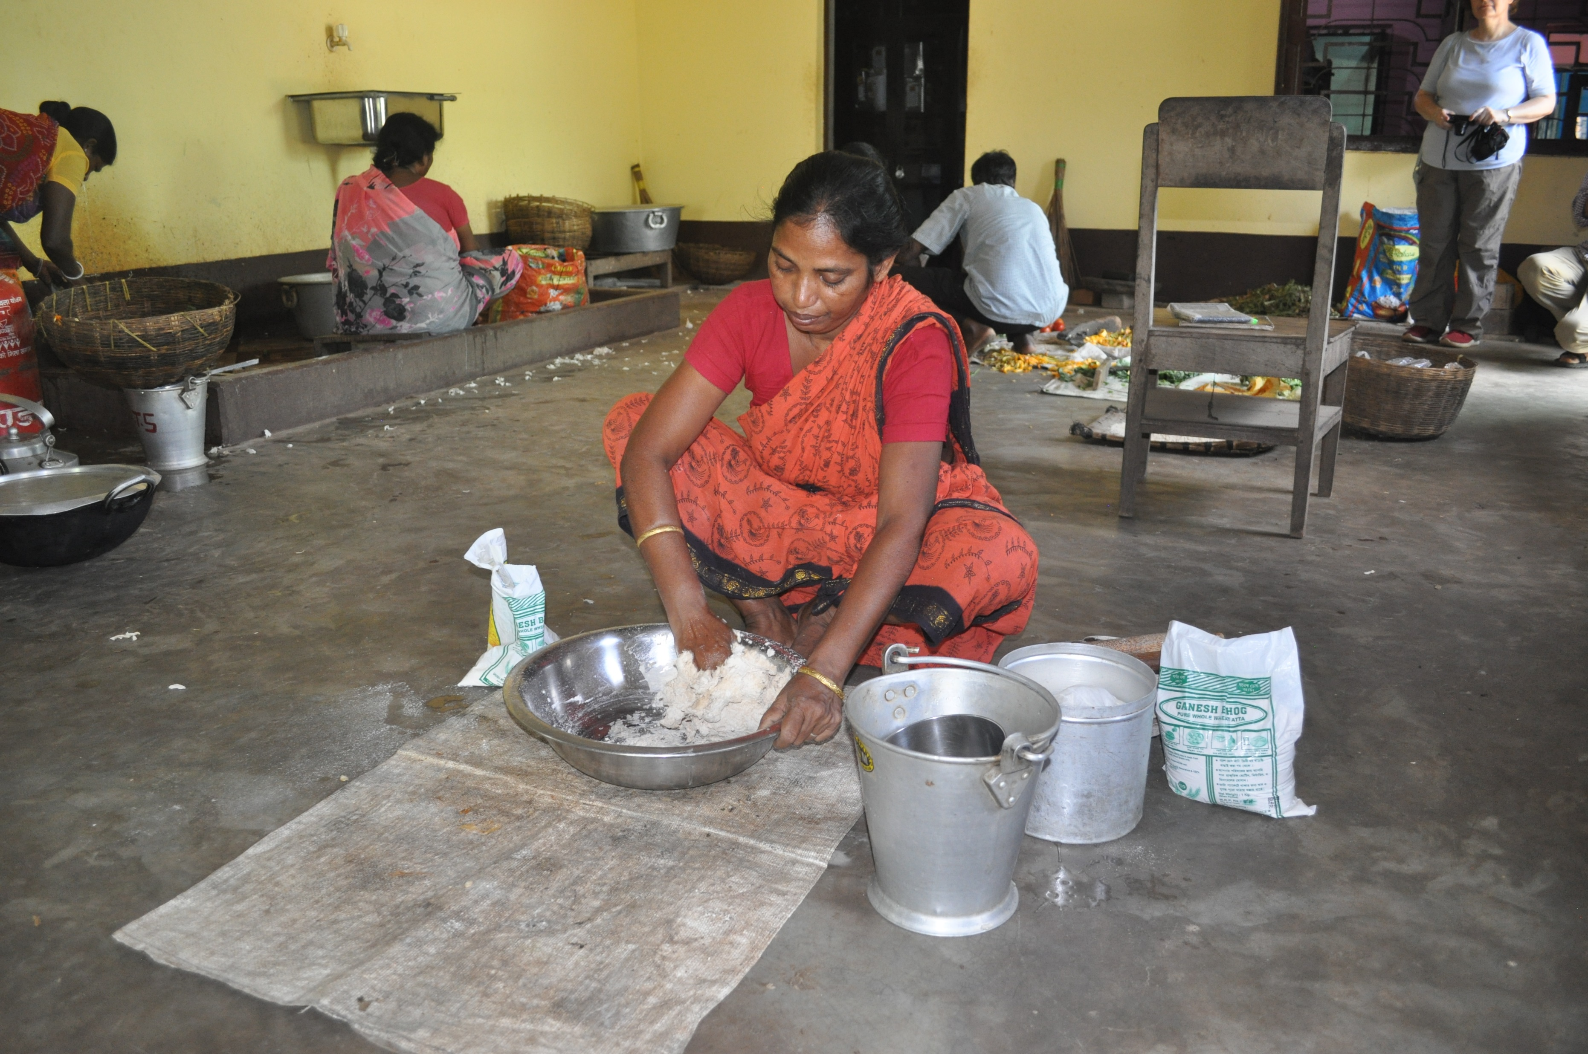
…with a similar design to the Nurses’ School kitchen…

Slide 37
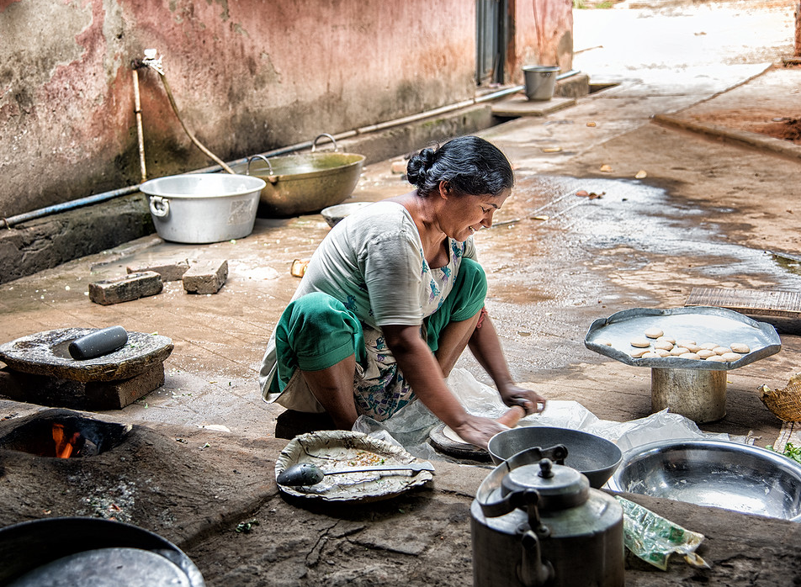
…which was an improvement on the old one!

Slide 38
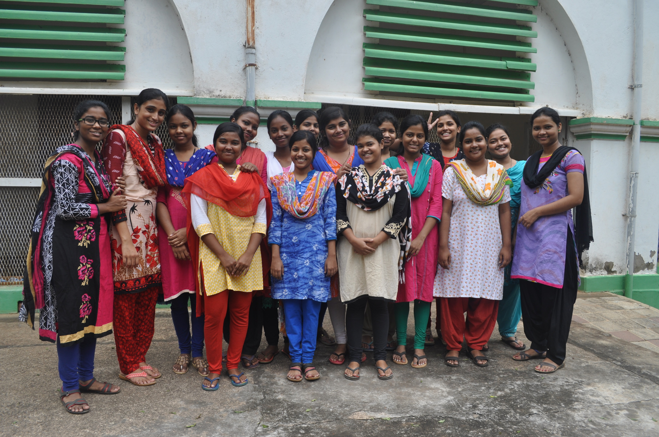
Yet there is always a warm welcome!

Slide 39
Thank you for your support!

