Slide 1
- living the life of Jesus today
All photos credited to www.unsplash.com
Notes:
In the coming years the United Reformed Church wants to place a greater emphasis on discipleship and mission,
under the banner ‘Walking the Way – living the life of Jesus today.
We are all called to follow Jesus. Disciples is who we are, discipleship is what we do.

Slide 2
The coming of the Spirit
Acts 2, 1-13 as told by children
Notes:
Here is how it all began. Well, almost. It began before that of course, with Jesus calling the disciples.
But this is when the Spirit came and the community of disciples grew till the ends of the earth.
[Show the video clip from Assembly of the children re-telling Acts 2, 1-13. This is in their own words – not scripted.]

Slide 3
What happened next? Disciples are… Sent by the Spirit Breaking bread Baptising Sharing and serving Praying and praising God Witnessing boldly Paying the price Ever learning
Notes:
What happened to the disciples of Jesus was most exciting.
Following the pouring out of the Spirit they told others of Jesus and carried on his work. And the church was born in belief, baptism and breaking of the bread, generosity and sharing.
They encountered opposition, but grew in confidence, witnessing boldly and the community continued to grow in unity, in trust in God, and in sharing and mutual support.
The disciples found their following was costly, but Stephen’s martyrdom led to a wide and successful mission.
Gentiles became disciples, leading the first disciples to learn how to share the gospel in ways that a Gentile would understand.
Like the disciples in Acts, we are called to discipleship too – in the power of that same Spirit who inspired them to follow Jesus and go where they had not been before.

Slide 4
Notes:
What does it mean to be a disciple today? At its most basic, a disciple is simply a learner, someone who is learning to follow Jesus (in this moment), growing in his/her relationship with him, with other people and with the wider world/creation.
This takes time, a life time, and it happens by doing it. There is no set way. There is no course that will tell you how to do it. It is simply setting out in faith, following Jesus and trusting in God. On the journey of faith we are always encouraged to take the next step and as we do so we make the road by walking.

Slide 5
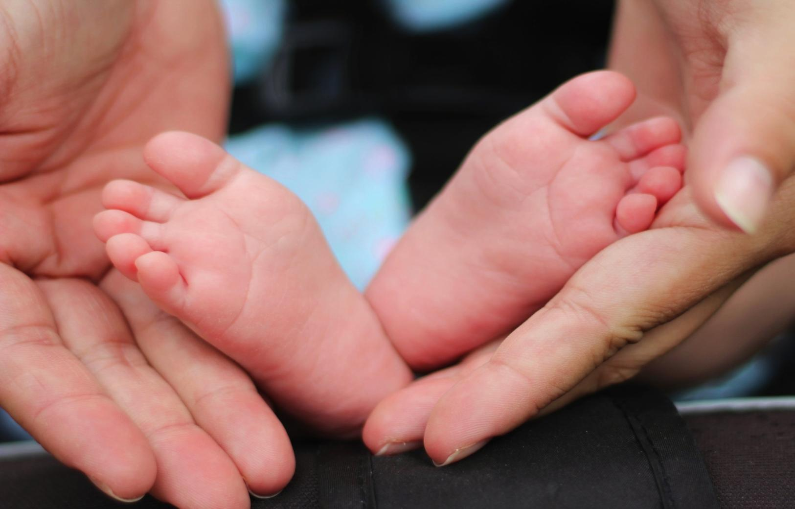
Notes:
The call to follow Jesus never stops. Discipleship is life long. There is always another step. There is always something new to be discovered.

Slide 6
Being a disciple can
be a struggle
with obstacles to overcome
Notes:
But being a disciple is not easy. It wasn’t then and it isn’t now. There are many things that can get in the way.

Slide 7
The church….
Buildings, people, apathy, fear of change
The world…
Culture no longer brings people to church
Suspicion of religion
Notes:
Things to do with church: upkeep of buildings, lack of people to do things, fear of change, apathy.
And things to do with the world. Our world has changed dramatically. Whereas before our culture brought people in contact with the church on a regular basis, now 60% of the UK population are believed to be beyond the reach of the church.
Many people are sceptical or suspicious of religion and faith. And media portrayal is often negative.
Where perhaps we never had to before, now we are called to give an account of the hope that is in us and that is a challenge.
This is a new landscape and it is not easy to see the way ahead.

Slide 8
Being a disciple today
A new landscape
The same mission
A fresh blessing
Notes:
But though the landscape is new, our mission is the same. People still have deep spiritual longings; and our world is crying for healing, justice and peace.
While we may wish to retreat into our own holy huddle, God tells us to seek the welfare of those around us and to be salt and light.
In this new landscape, God’s mission is the same and God continues to call his disciples to be a fresh blessing.

Slide 9
Notes:
Walking the Way is there to support you and your church as you respond to God’s call to discipleship and mission.
Walking the Way – living the life of Jesus today is a new emphasis in the United Reformed Church which will come into focus fully later this year. Its aim is to
refresh and grow our habits of discipleship and mission and to support you and your church on your discipleship journey.
So that we think naturally that DISCIPLES IS WHAT WE ARE and DISCIPLESHIP IS WHAT WE DO.

Slide 10
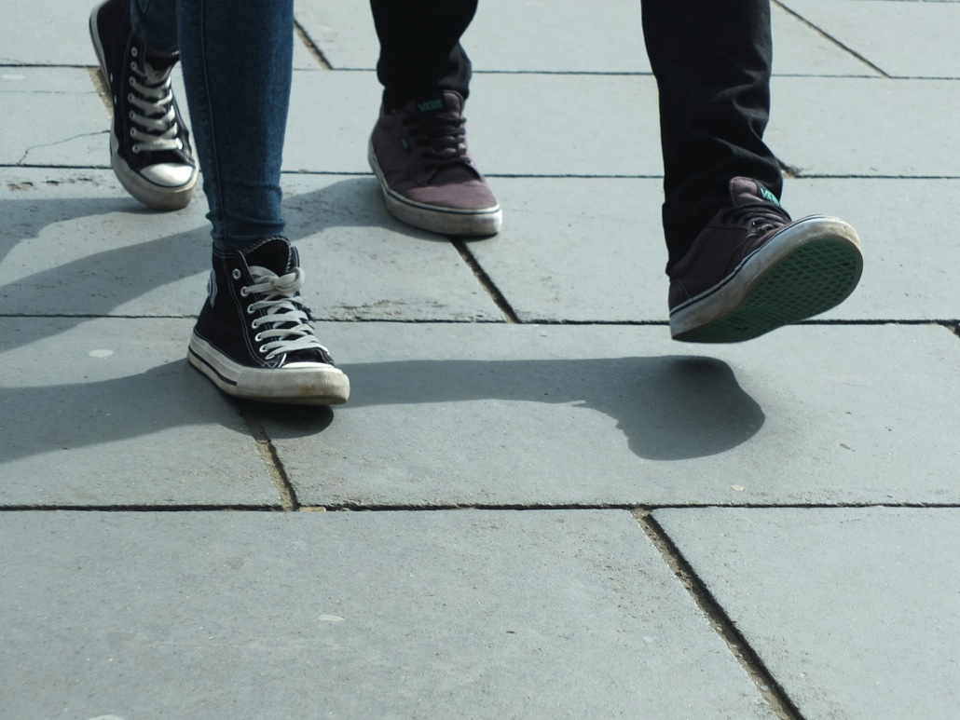
Photo credit: Peter Hershey
Notes:
Walking the Way aims to support you in your discipleship. A discipleship that is about all of life. Not just the bits that are to do with church but all the parts of our life: school, work, family, friends, sport, rest, politics, you name it. It is all important. Every aspect of our life matters to God.
Walking the Way aims to support you in your discipleship, not only when we are together on a Sunday morning (and let’s face it, much of our energy in church goes to that) but also when we are scattered. During the week. When we are out there. Interacting with others, sharing our faith and showing how Christ makes a difference in our lives.
It is there that we need the constant building up of faith and the support and encouragement of the church community - to live our whole lives as faithful followers of Jesus, as missionary disciples.

Slide 11
Holy living The more we receive in silent prayer, the more we can give in active life. (Mother Teresa) ￼￼￼￼￼
Notes:
Followers of Jesus, disciples, who hold together being and doing, prayer and action, in all of life.

Slide 12
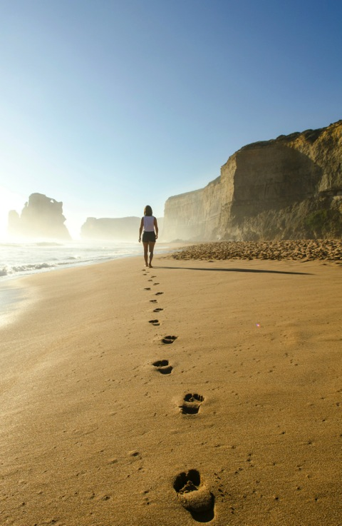
The habits of discipleship
Notes:
One way of building up our faith and supporting each other is to refresh our habits of discipleship.
In the book of Acts we see that the community of disciples developed certain practices and habits to support each other and to grow in faith and fellowship: they met regularly, they prayed, they broke bread together, they looked after each other, they shared.
In our tradition much emphasis was given to these things too: the habit of studying the Bible, of prayer and worship.
Walking the Way is about rediscovering these habits and their meaning for us today.
They are the holy habits of Bible study, fellowship, breaking bread, prayer, giving, service, eating together, gladness and generosity, worship, and making more disciples.

Slide 13
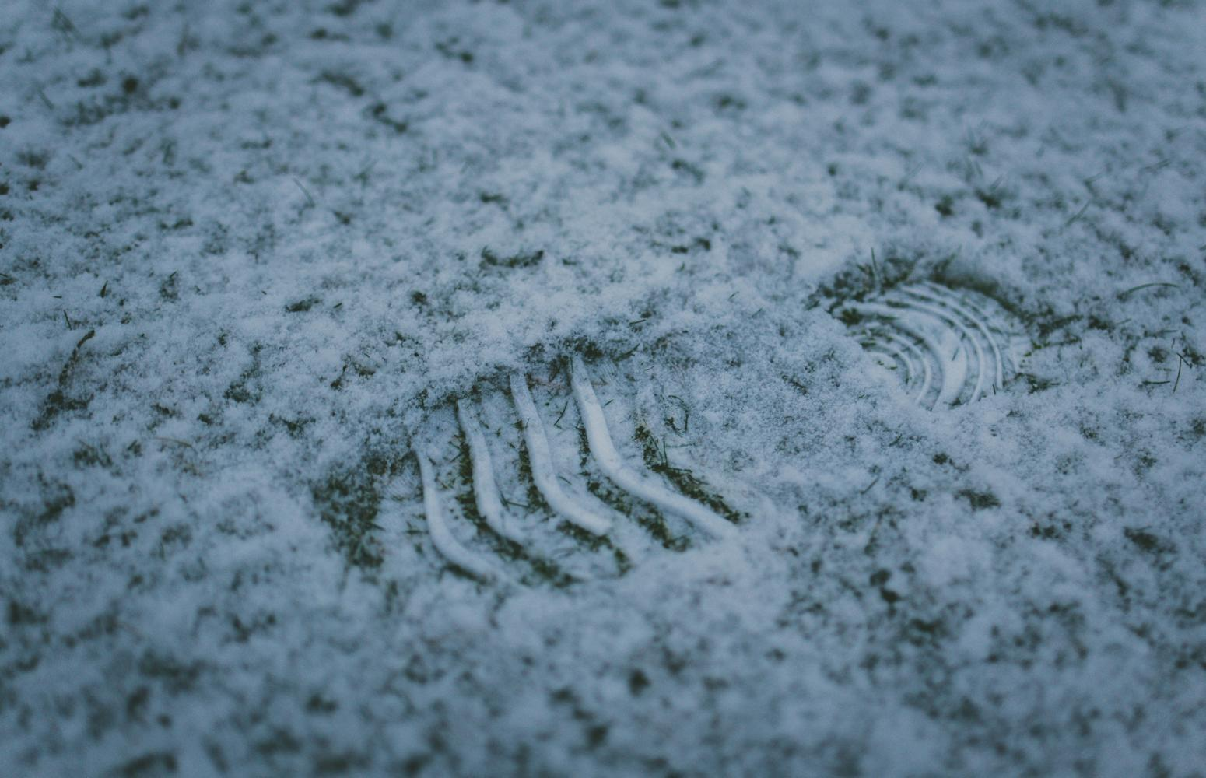
Just imagine…. From Church focus to Christ focus From settled Church to a Church as a movement From a culture of guilt to a culture of grace From running congregations to building communities From faith as security to faith as risk
Notes:
Rediscovering these habits would help us to grow as disciples and as communities of character that make a difference to the world for Christ’s sake.
And just imagine what that could mean for us and for our church life locally and beyond:
Our focus might be less on church and more on Christ
Our church might be less settled and more of a movement
Our actions might be motivated less by guilt and more by grace
We would not talk of running congregations but of building communities
And our faith would be about taking risk rather than seeking security.
Just imagine what such a Church could be for the world.

Slide 14
- living the life of Jesus today
Notes:
Walking the Way – living the life of Jesus aims to refresh and grow our habits of discipleship and mission. It is to support you and your church in your discipleship journey – in being disciples, making disciples and transforming the world. What Walking the Way is not is an extra thing, but something you already do. It is not novel, it is rediscovering something that is normal and to make it a priority again.

Slide 15
The story so far….
Notes:
Walking the Way began with Mission Council in 2013 which highlighted the need for a focus on ‘pre-evangelism and deepening discipleship.’ At almost the same time the review of the Training for Learning and Serving (TLS) course in 2014-2015 concluded that its successor should have a broader focus on discipleship of all God’s people. A steering group then set about devising a discipleship scheme for the URC which reflects commitment to mission of God and which can equip every congregation with servant leadership which is imaginative, flexible and courageous. It was given the name Walking the Way – living the life of Jesus today.
General Assembly 2016 welcomed and endorsed the new emphasis.

Slide 16
What it is not ….
Another ‘must’, on top of present duty
A moment in time
Evolved in detail. What would help you?
Notes:
What Walking the Way is not is yet another ‘must’ on top of present duty. It is a fresh means to do what we do anyway, and perhaps to help you give it more priority in what you do.
It is not a moment in time. It is to last for a decade or more. It is about our ethos, our witness and our capacity to relate to God and neighbour. And that takes a long time.
It is also not evolved in detail. We are introducing you to some of our thinking but it has not yet evolved fully and we would really like to know what would help you.

Slide 17
What is coming?
Spring and Autumn resources for Synods (2017)
A leaflet and worship material for churches (September 2017)
Holy Habits (September 2017)
Lent materials (2018)
A new discipleship course to replace TLS (2018)
…..and much more (2018 and beyond)
Notes:
But…in the meanwhile we are preparing some introductory materials……but it isn’t all fitted out yet.
So here’s what’s coming.
Resources for the synod meetings in 2017 (e.g. this powerpoint and more for the synod in the autumn).
An introductory leaflet with worship materials for local churches in September 2017.
September 2017 will also see the publication of Holy Habits, a course for local churches to explore the ten holy habits in Acts in groups and individually. We are producing this together with the Methodists and highly recommend it.
There will be Lent resources for 2018.
And the eagerly expected replacement for the TLS course, which will be launched in September 2018.
And there will be more as we go along…

Slide 18
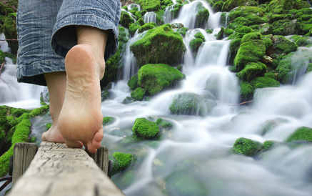
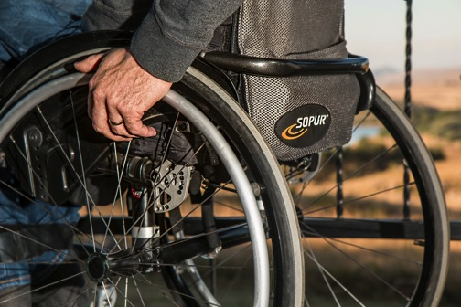
Followers of the Way….
Notes:
Discipleship...
It is our calling, for all of us.
It is about all of life (not just church) and lifelong.
Walking the Way is to support you on your journey of faith and to encourage you and your church to take the next step as followers of the Way.

Slide 19
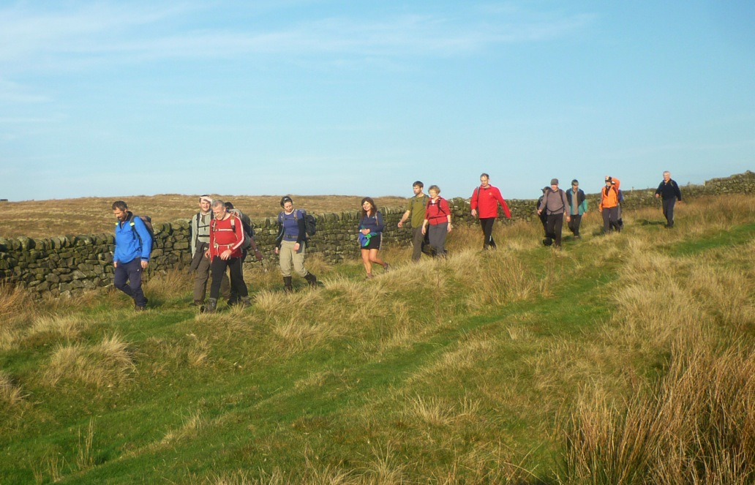
Notes:
Questions and conversation

